Slide 1

INTRODUCTION TO TMC ACADEMY

Slide 2

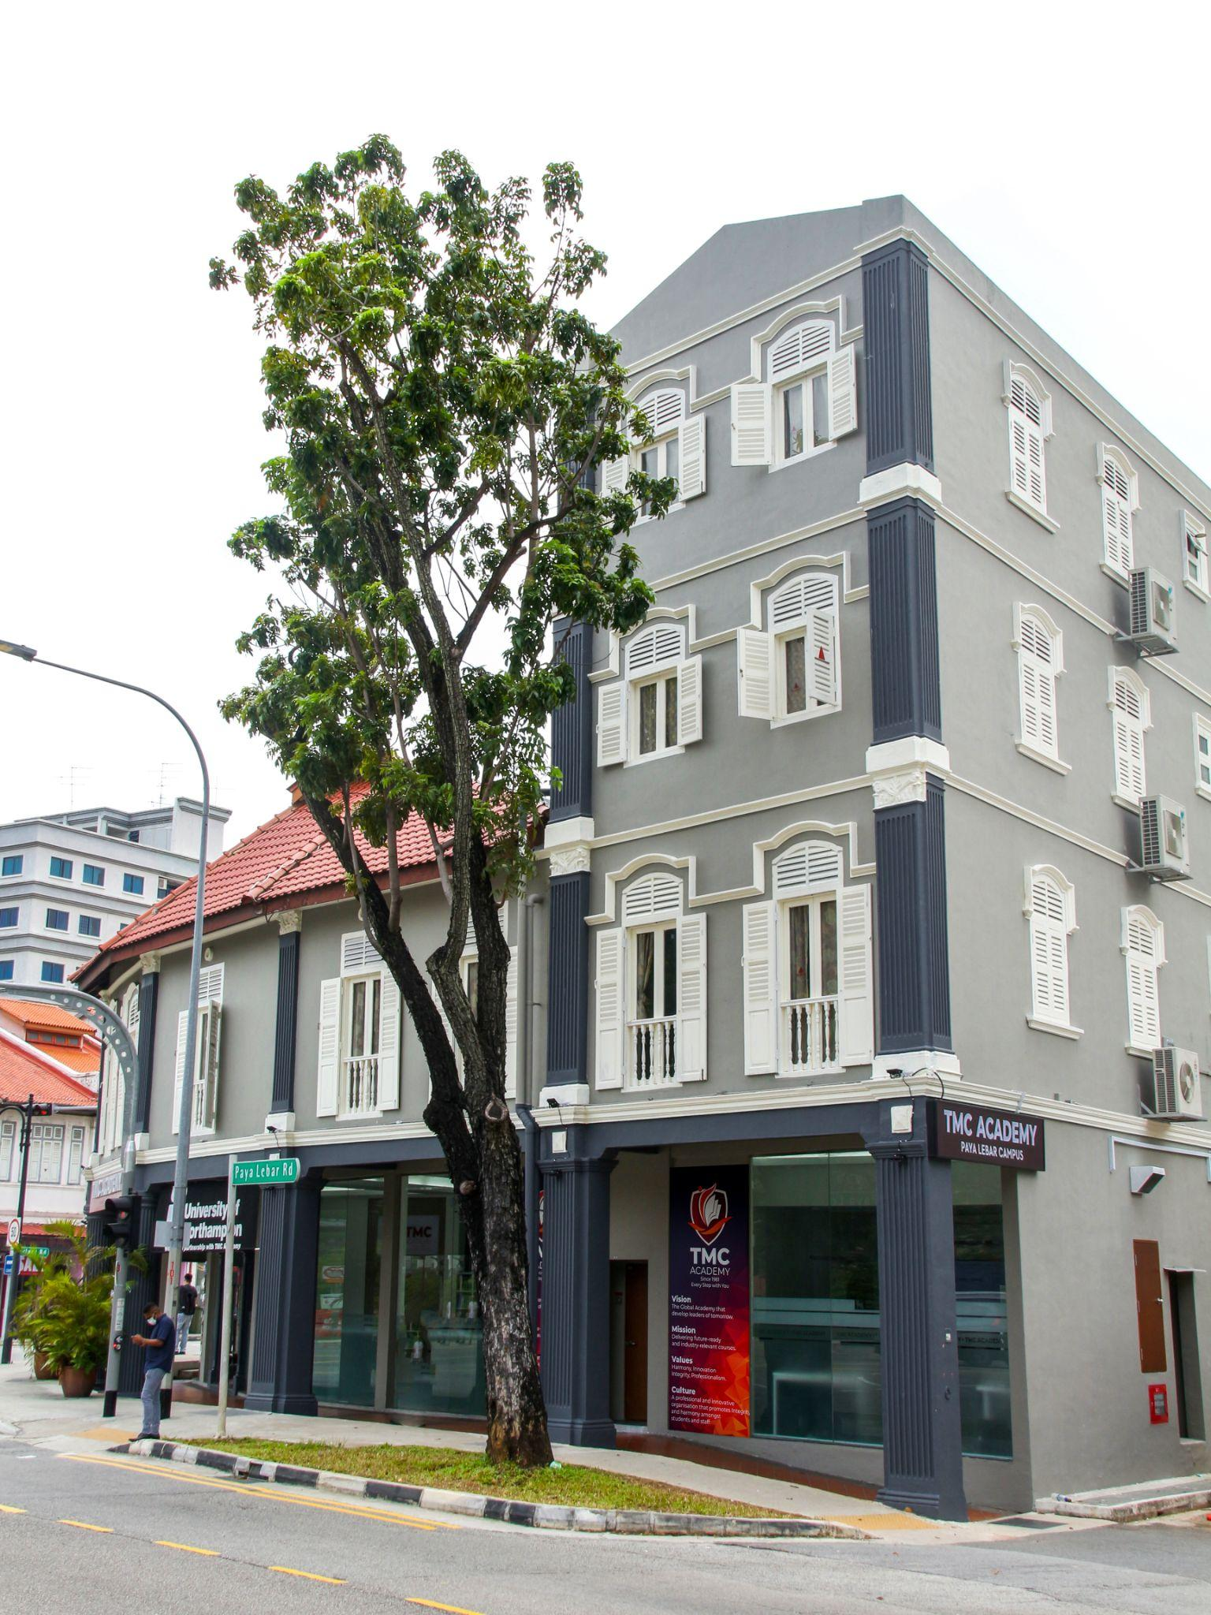
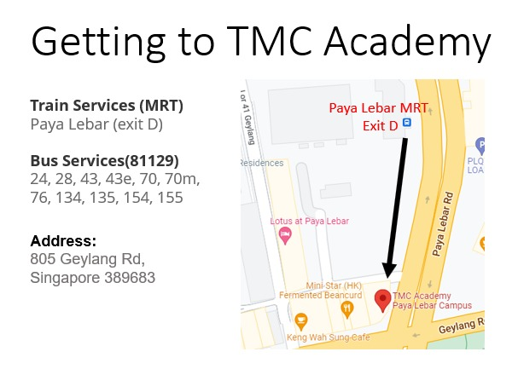
TMC ACADEMY, SINGAPORE
Located 50 meters from Paya Lebar MRT Exit D, 15 minutes from the central of Singapore by Bus/ MRT
Established 41 years, TMC Academy is one of the well-known private institutions in Singapore.
With students coming from more than 30 countries and regions
One of the first six private institutions to receive the EduTrust certification from the Government Private Education Council (CPE)
Diplomas are widely recognized
by universities around the world.
Students can further study at
universities in Europe and
the United States and perform
credit transfers.

Slide 3
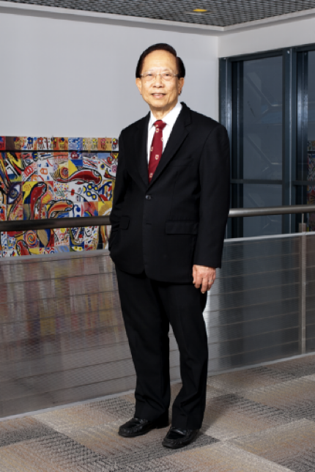
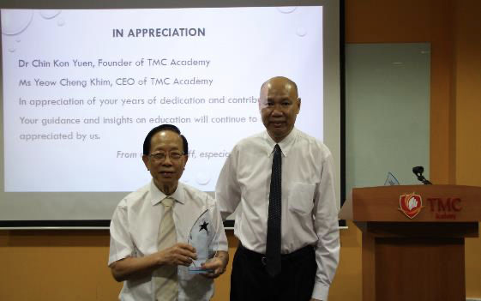
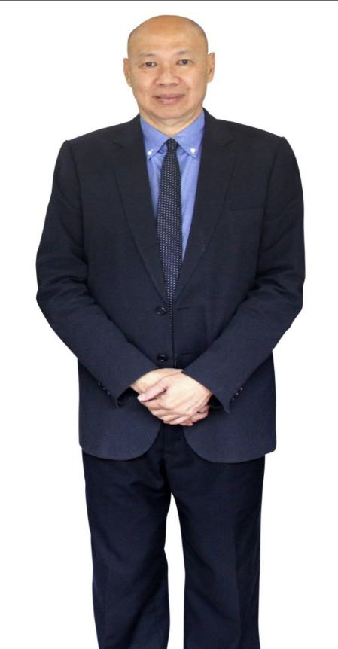
TMC ACADEMY, SINGAPORE
Mr. John Lee is the successor of TMC Academy. Mr. Lee has more than 40 years of experience in education and running schools in Singapore and abroad.
Vision: The leading academy that develops successful and high performance graduates.
TMC is founded in 1981
by Dr. Chin Kon Yuen

Slide 4
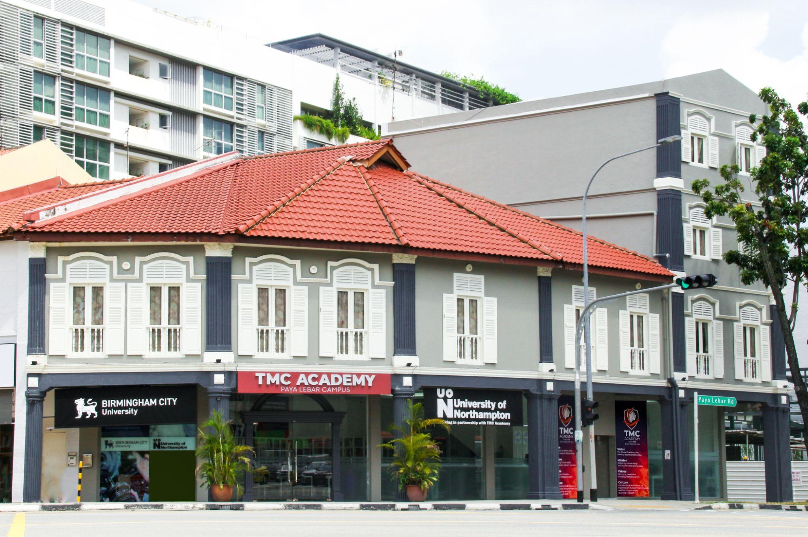
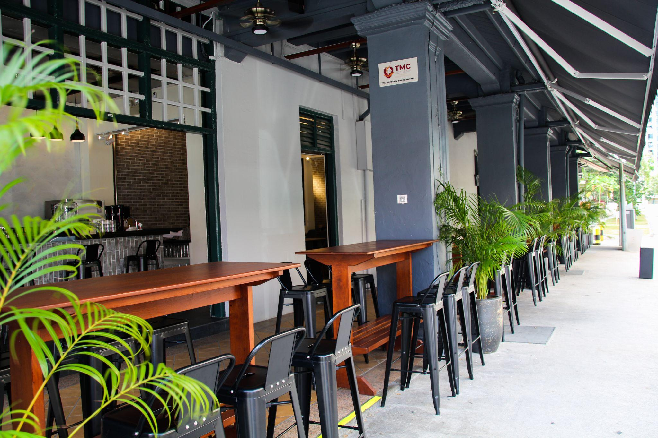
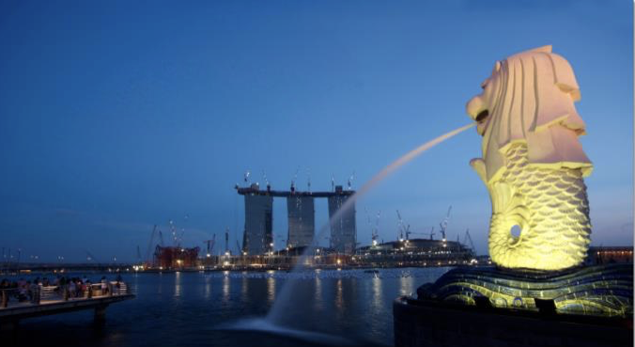
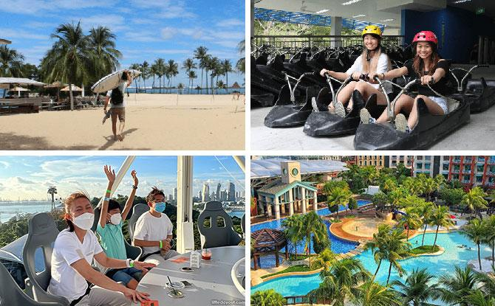
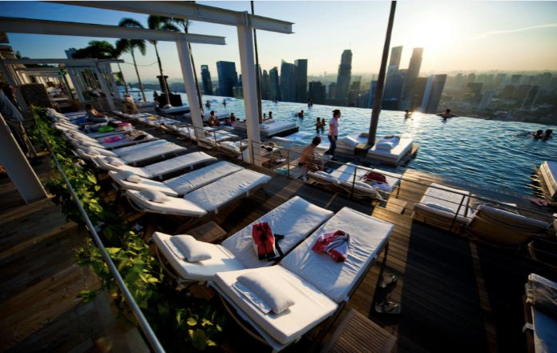
PHOTOS (CAMPUS AND LEISURE)

Slide 5
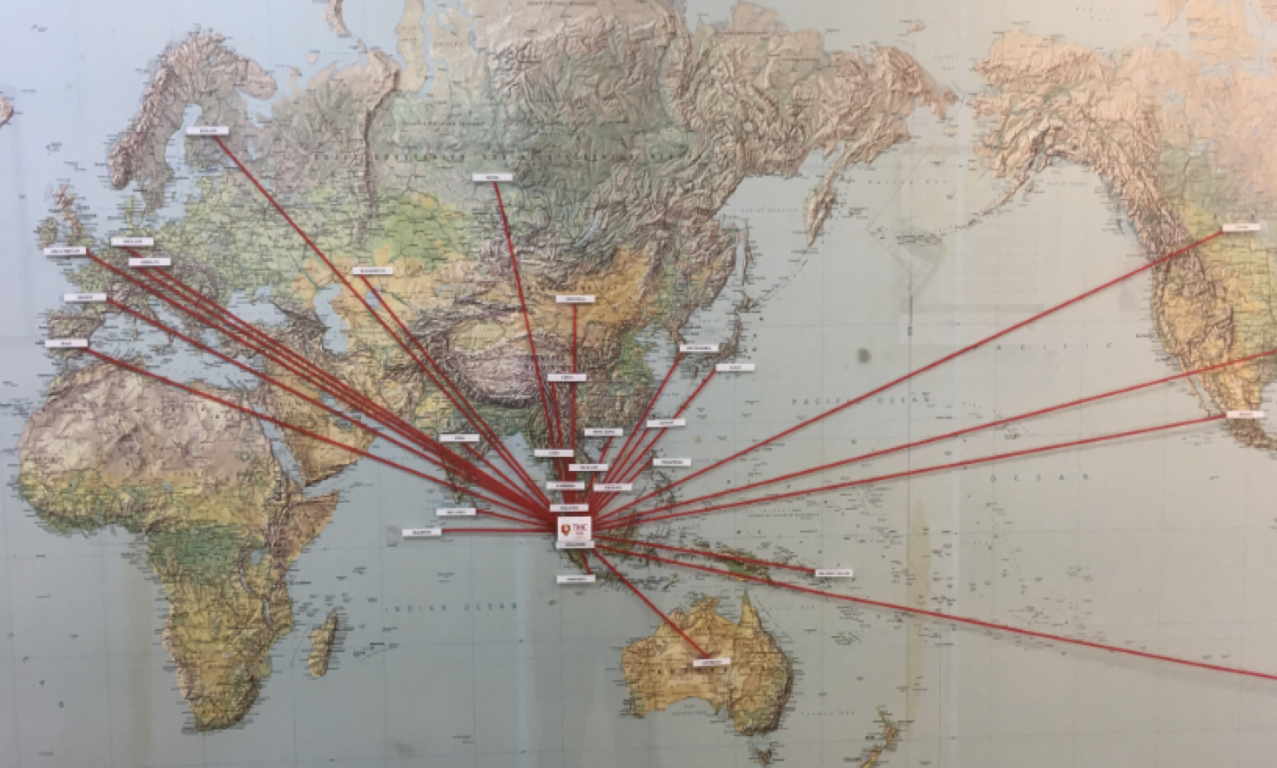


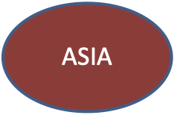
STUDENT NATIONALITY
TMC Academy has students coming from over 30 countries. These countries include Indonesia, Korea, China, Russia, Japan, Thailand, Vietnam, Mongolia,Myanmar, Philippines, Laos, Cambodia and more.

Slide 6
Facilities Capacity
No | Classrooms | Capacity
1 | PLQ #01-01 | 27
2 | PLQ #01-02 | 32
3 | PLQ #01-03 | 21
4 | PLQ #01-04 | 12
5 | 805 Room 101 | 10
6 | 805 Room 102 | 17
7 | 805 Room 201 | 81
8 | 805 Room 301 | 30
9 | 805 Room 401 | 30
10 | 732 | 60
11 | 732B1 | 30
12 | 732B2 | 8
No | Classrooms | Capacity
13 | 730B1 | 30
14 | 730B2 | 8
15 | 728B1 | 30
16 | 728B2 | 8
17 | 730A1 | 25
18 | 730A2 | 30
19 | 728A1 | 25
20 | 728A2 | 30
21 | GrandLink | 80
 | Total Capacity per session | 624 Students

Slide 7
Estimated students, academic lecturers & Staff
TMC existing students (Full time & Part time) Depending on the enrollment, it can differ more or less | 550 students
TMC existing staff (Full time & Part time) | 90 staff (including lecturers)
TMC Lecturer only (Full time & Part time) | 35 lecturers

Slide 8
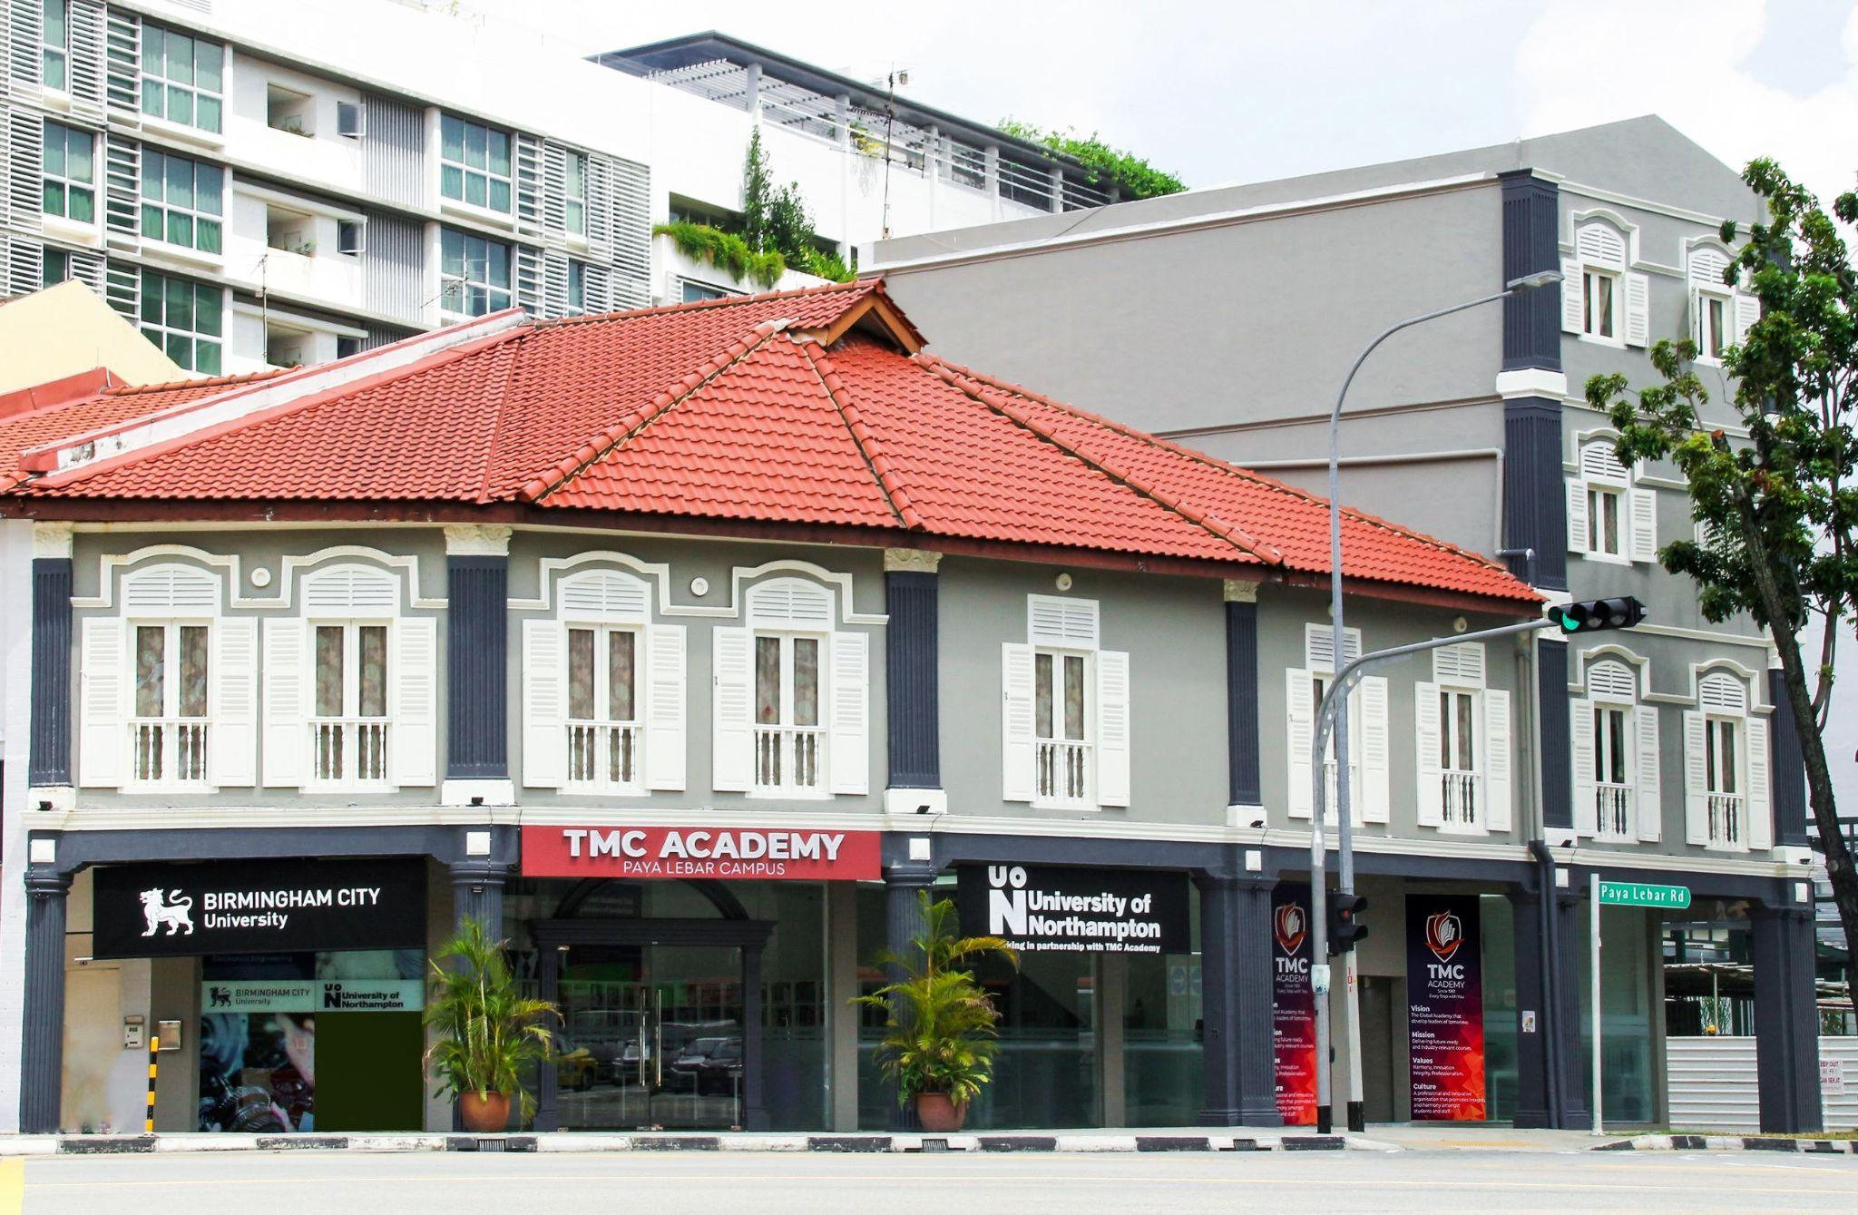
Facilities
Campus Front

Slide 9
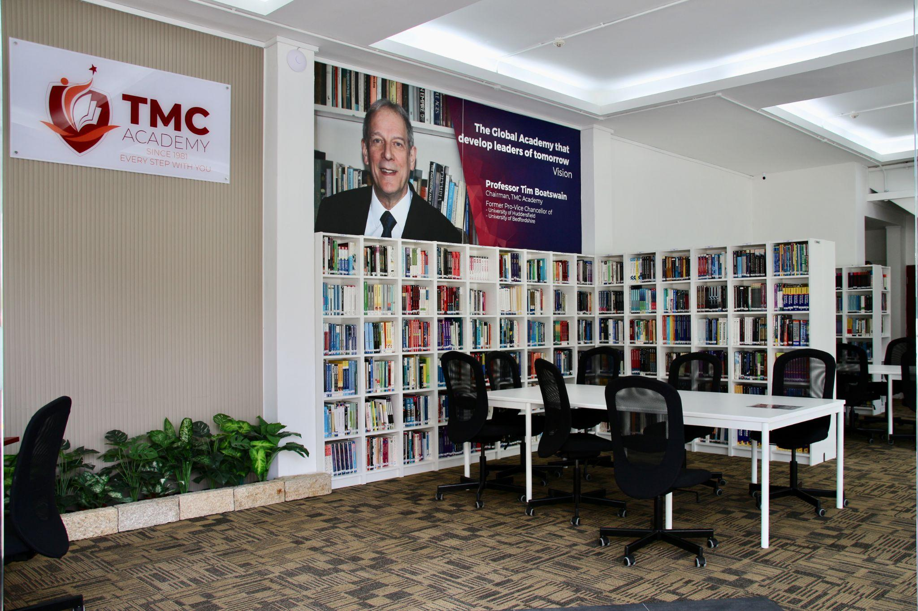
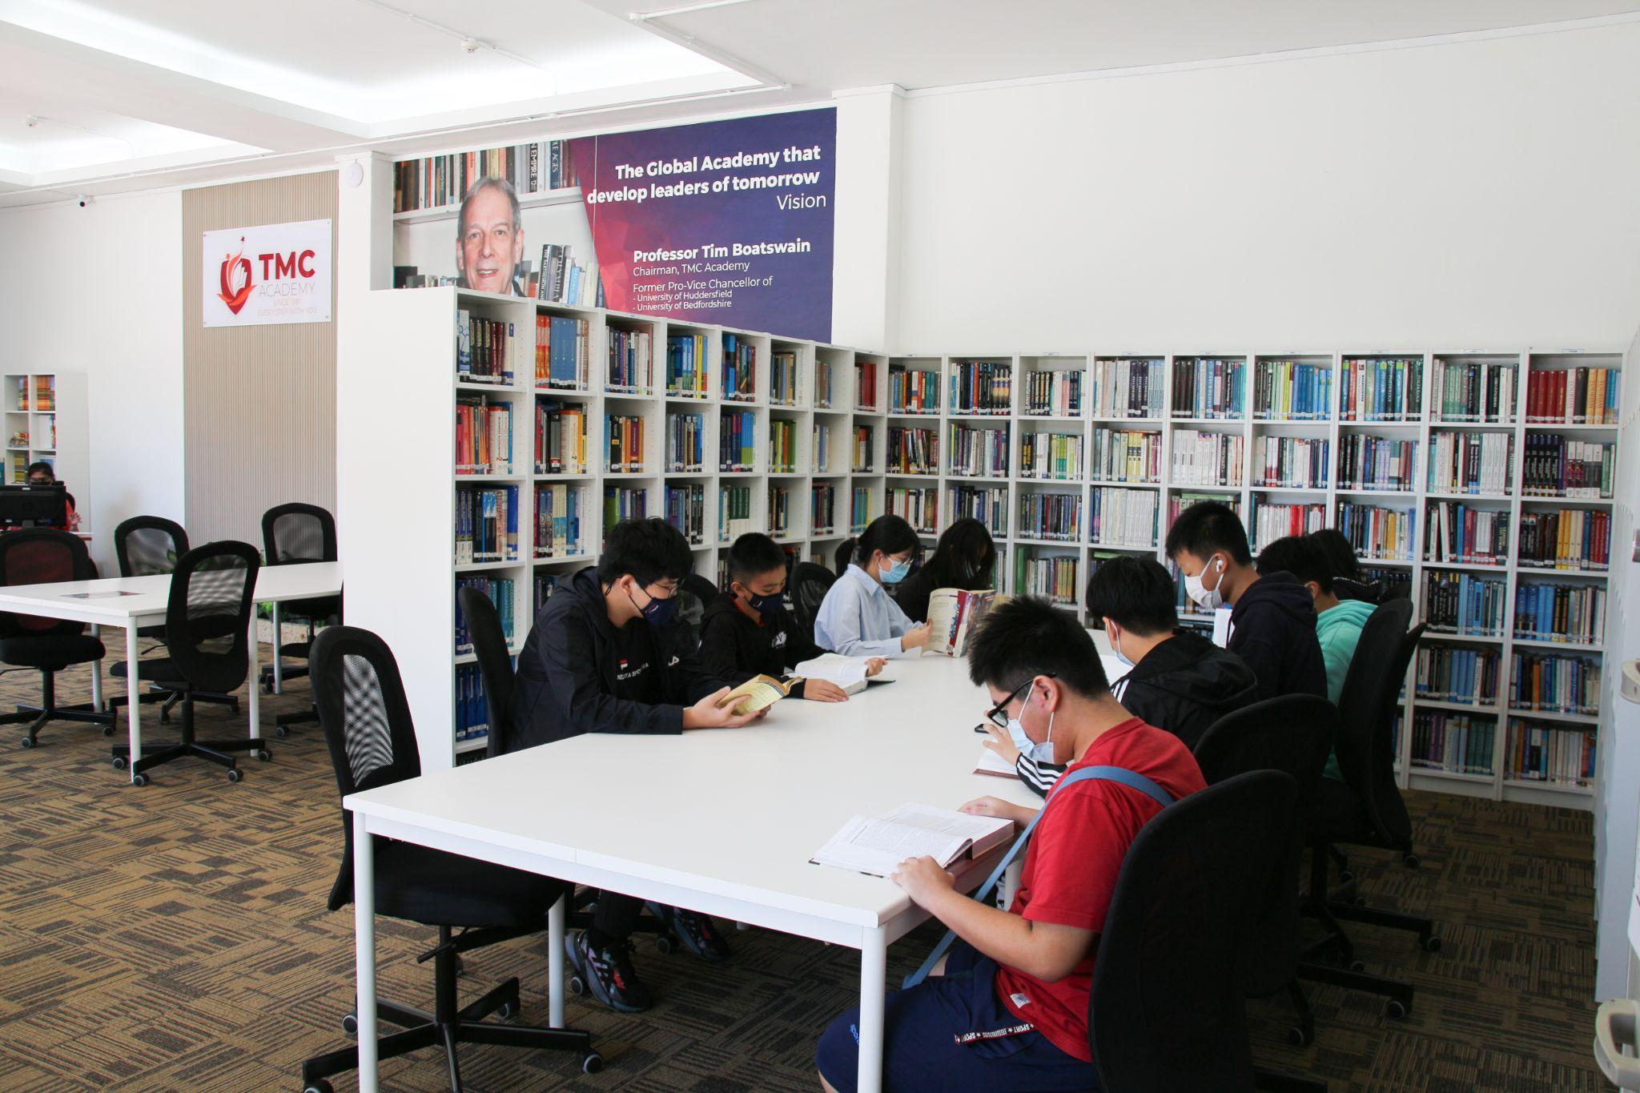
Facilities
Library

Slide 10
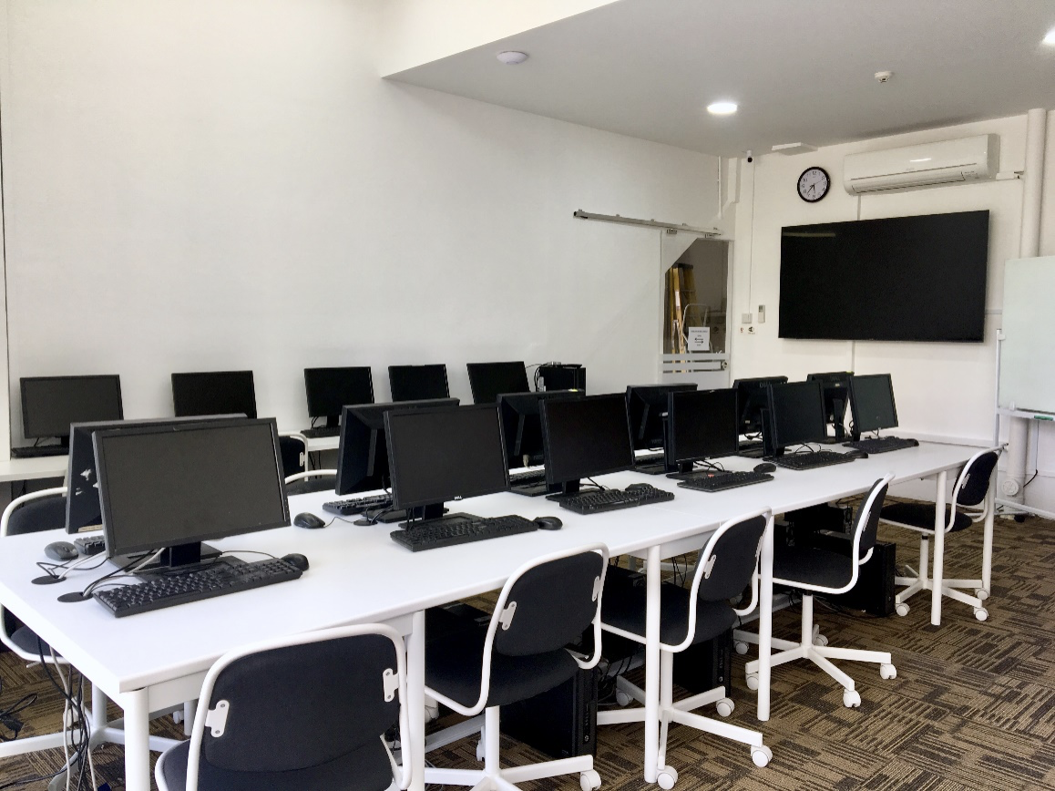
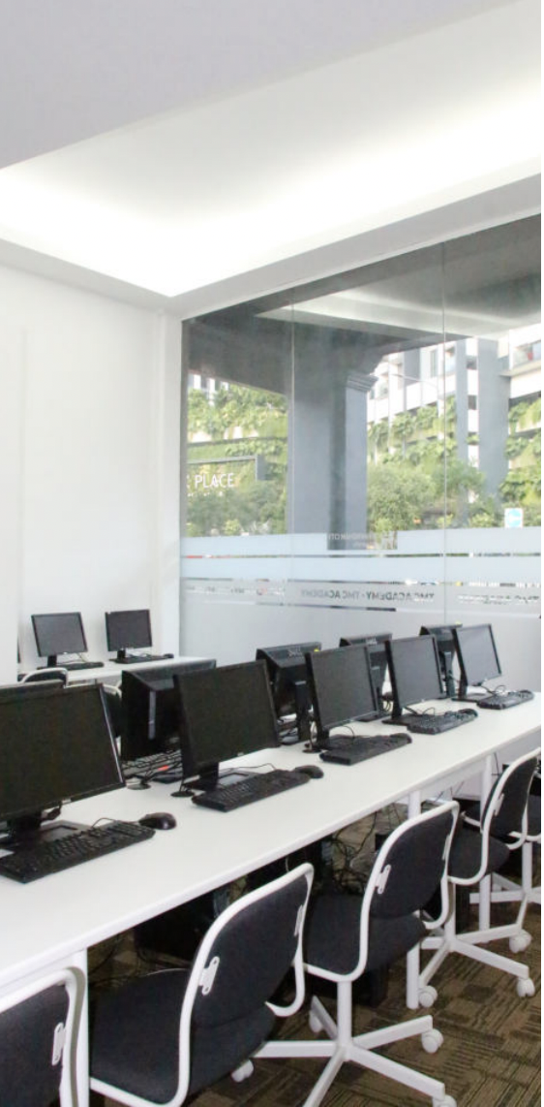
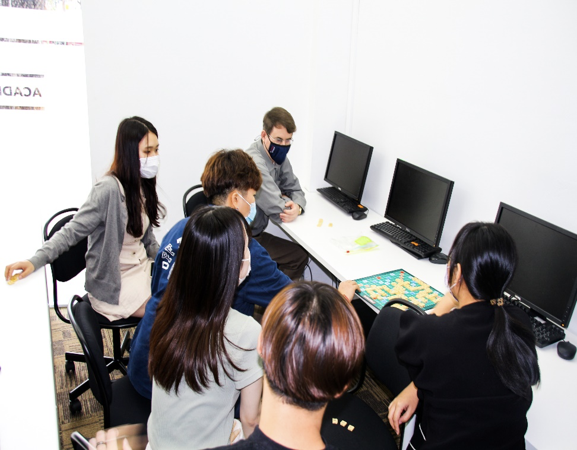
Facilities
3 Computer Lab

Slide 11
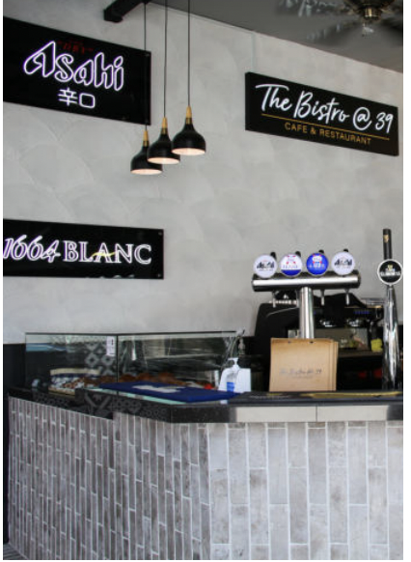
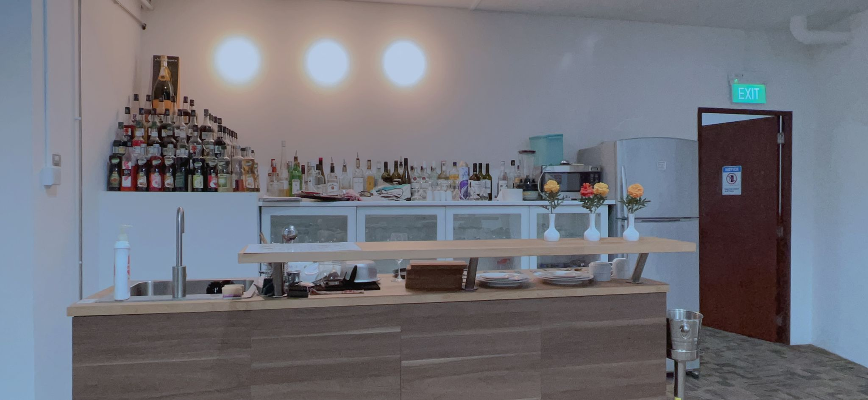
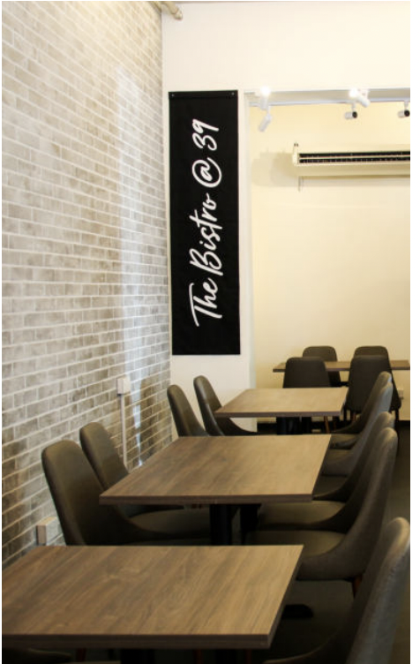
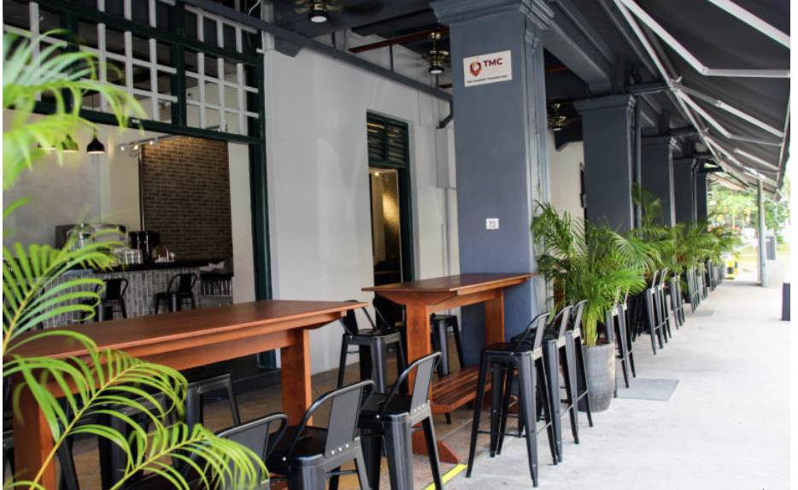
Facilities
Training Hub

Slide 12
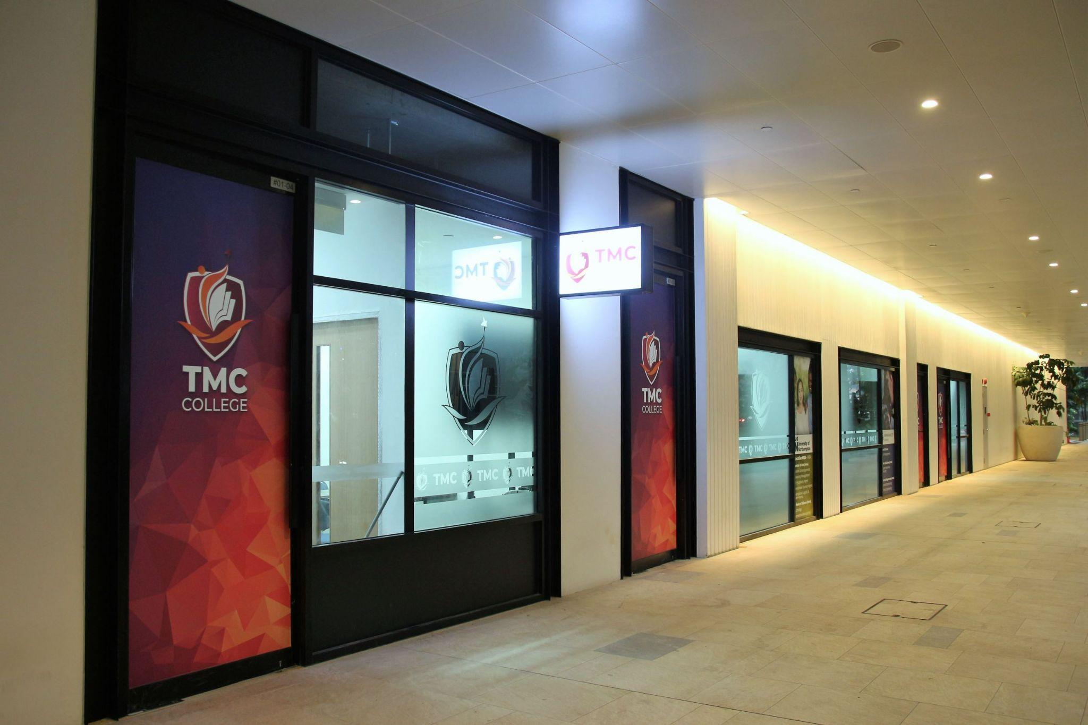
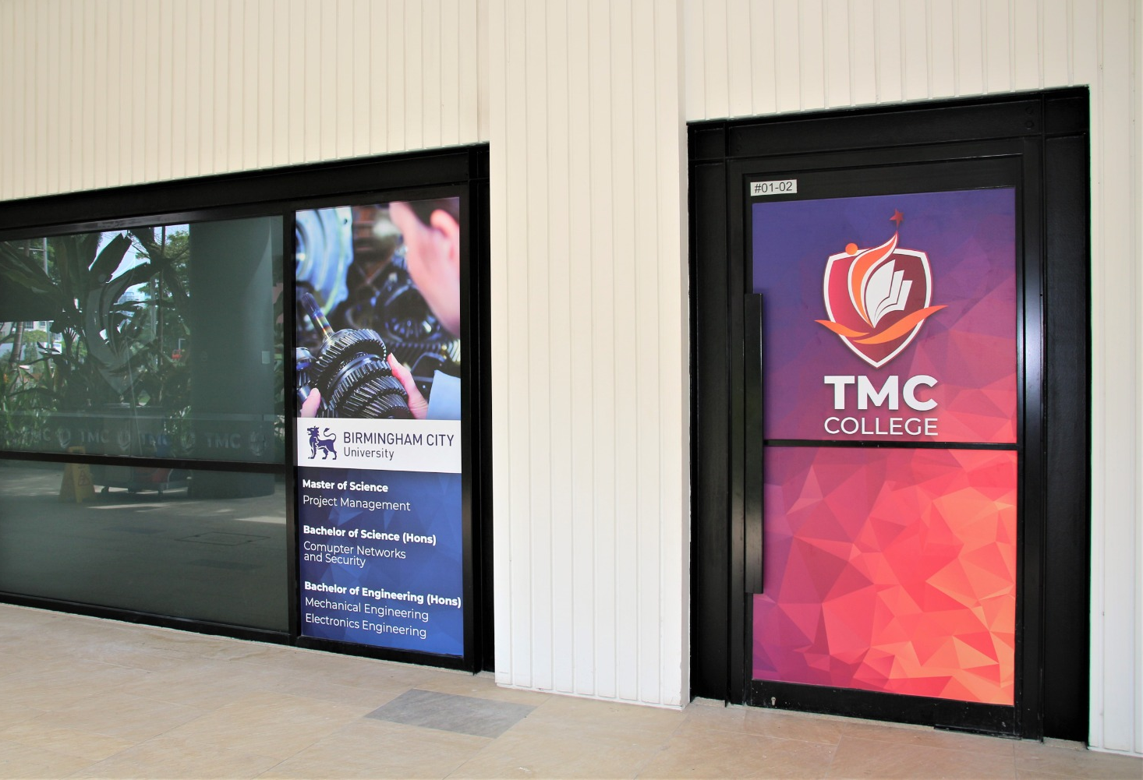
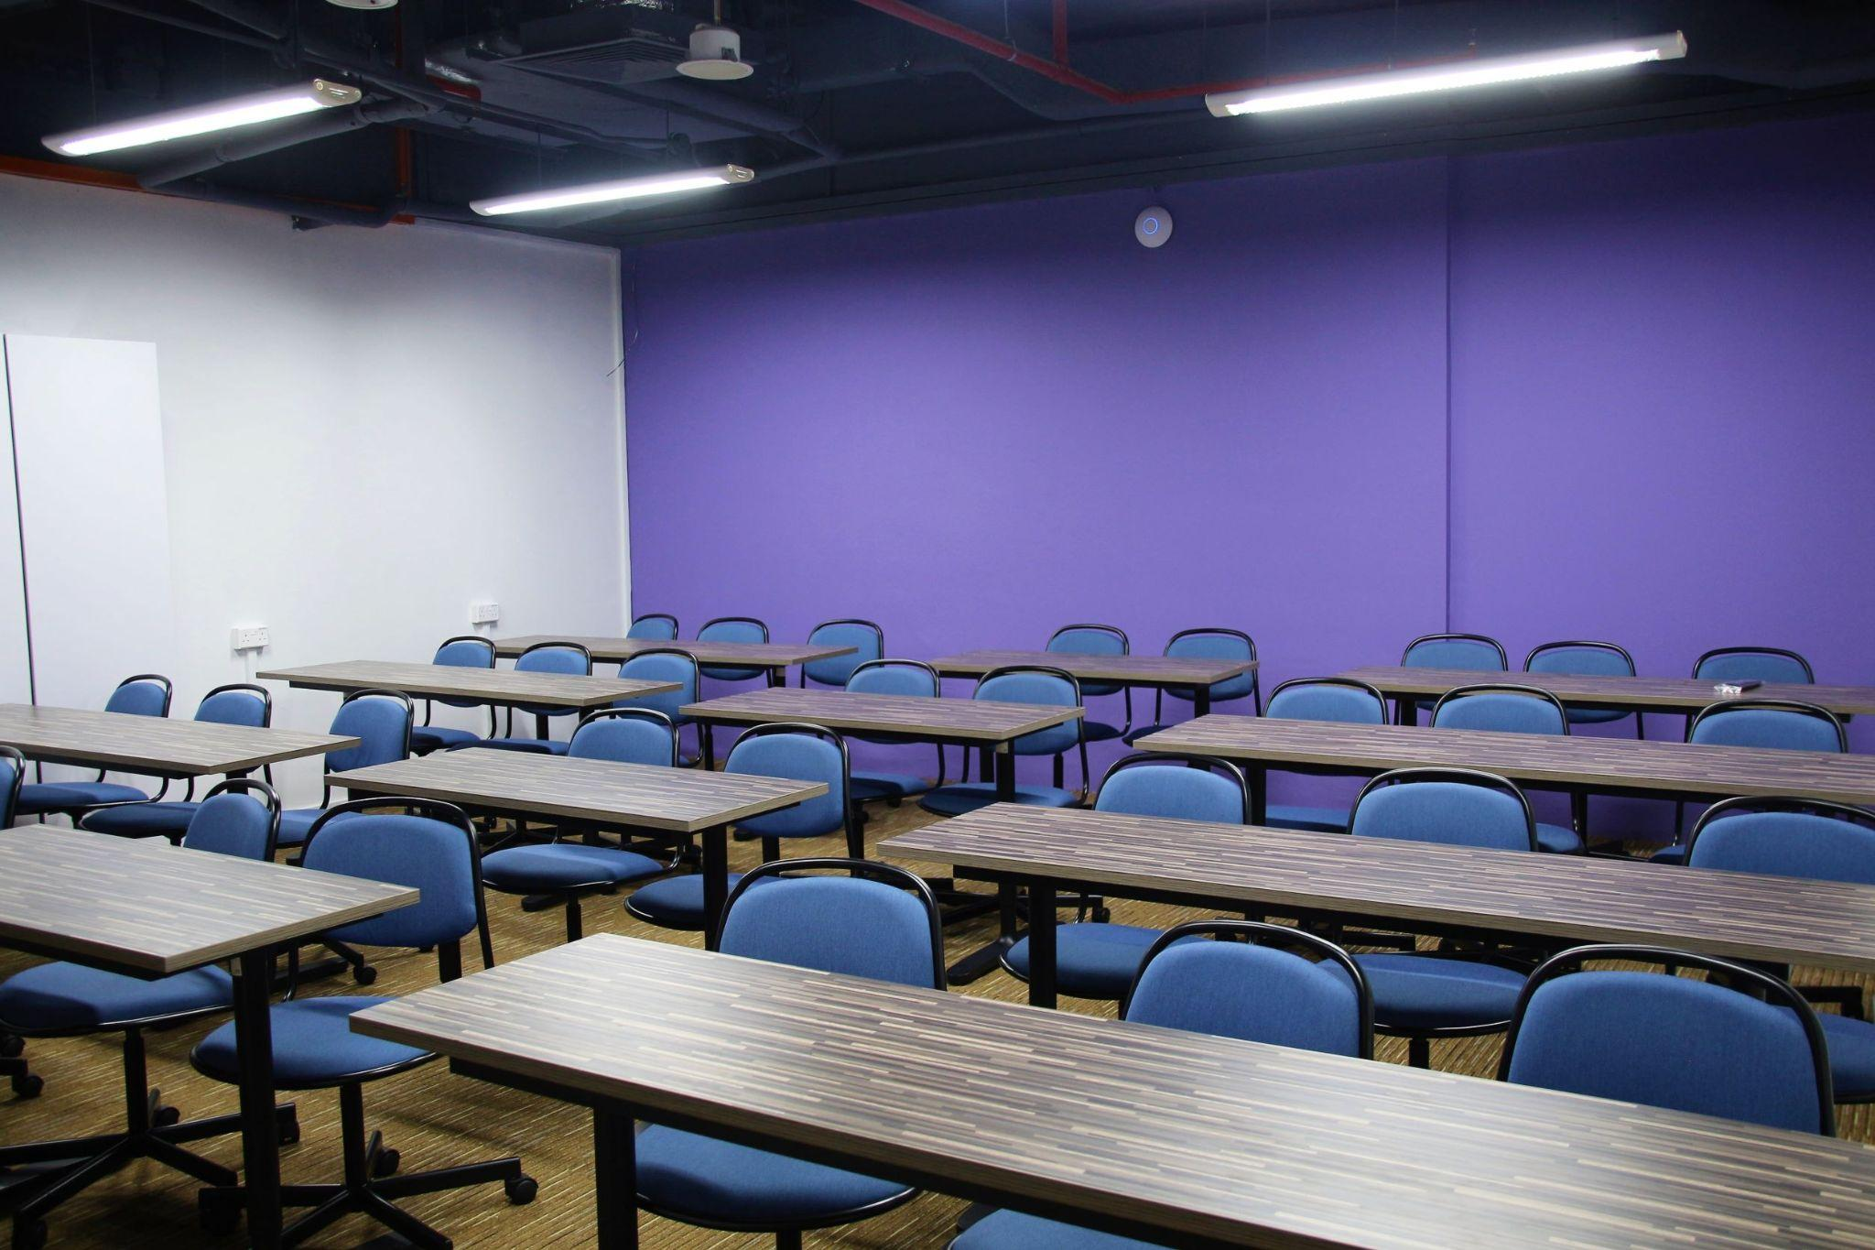
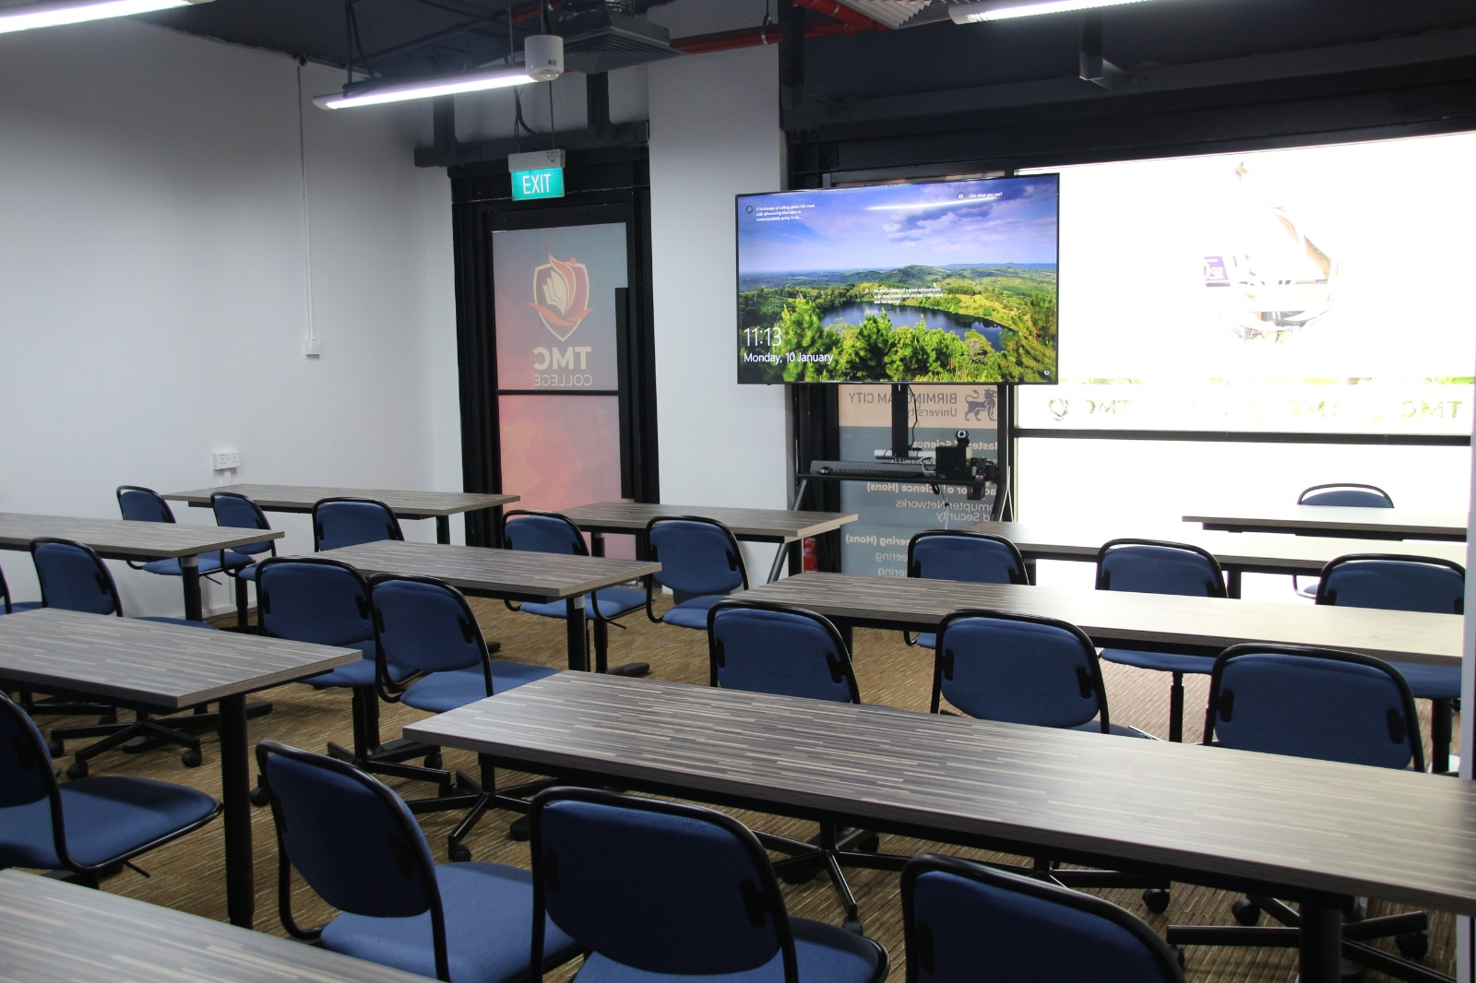
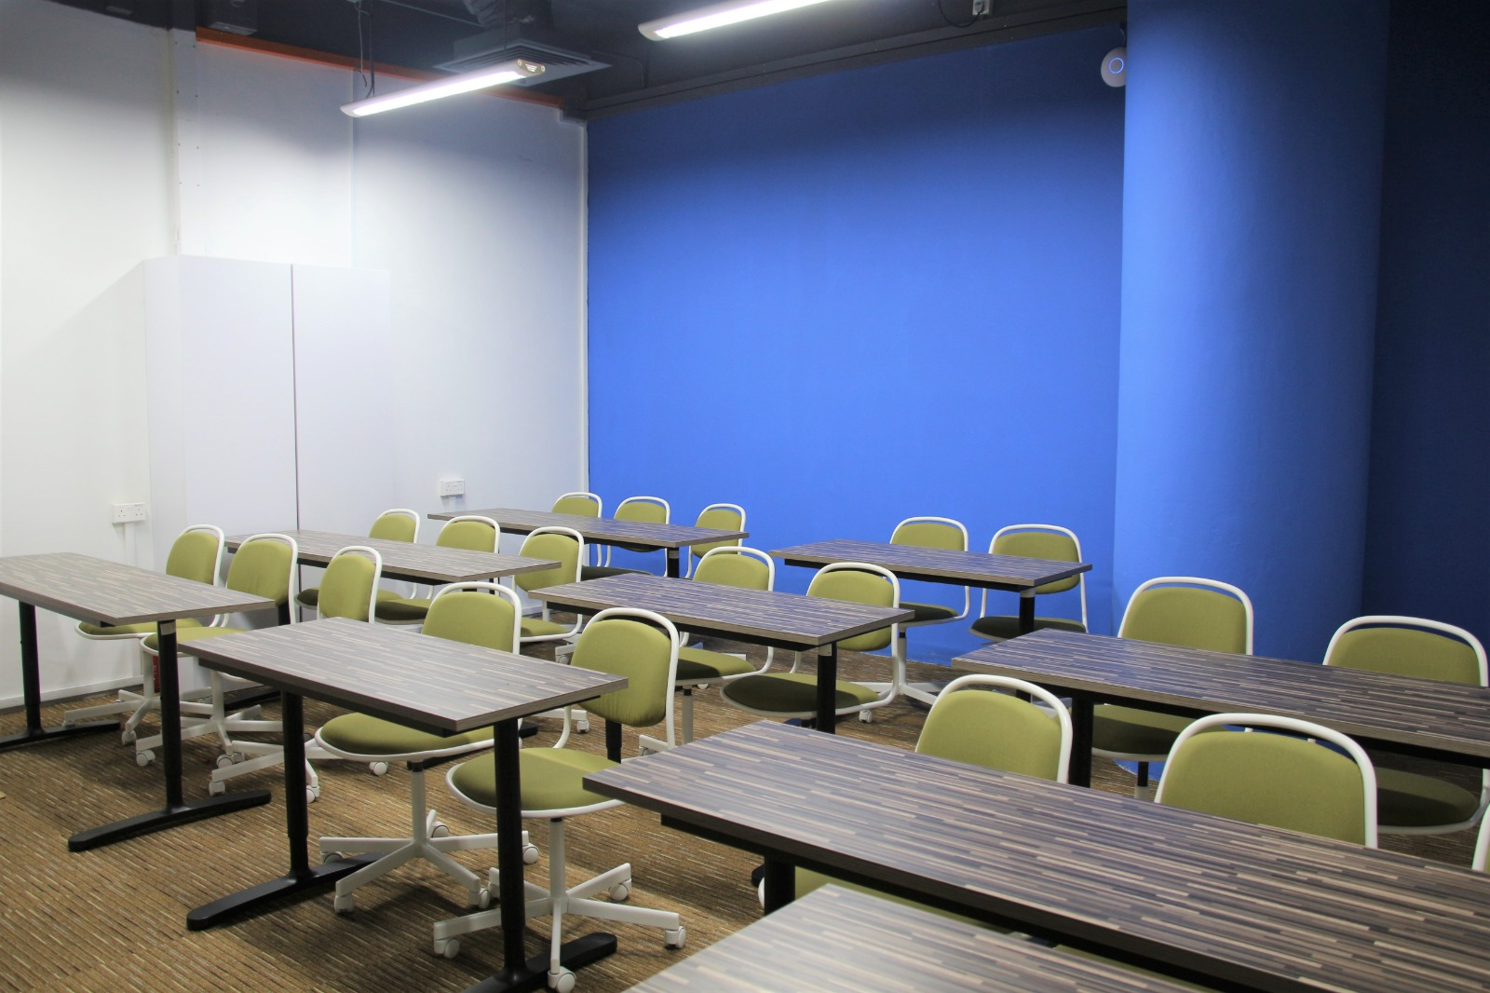
Facilities - TMC College
Classrooms

Slide 13
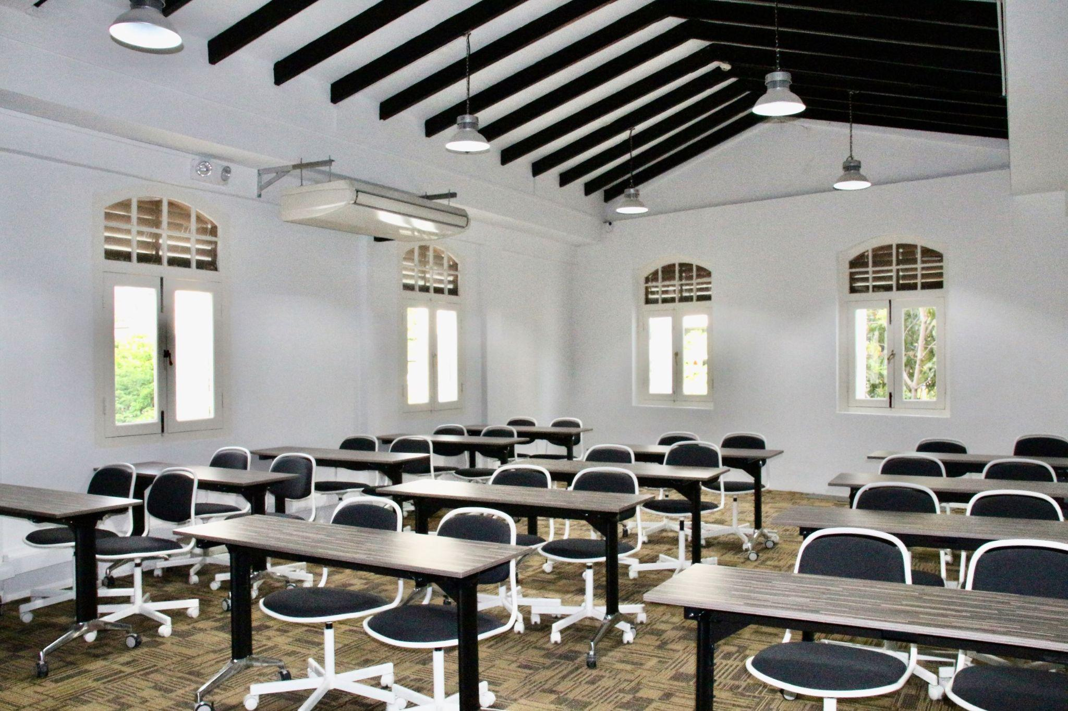
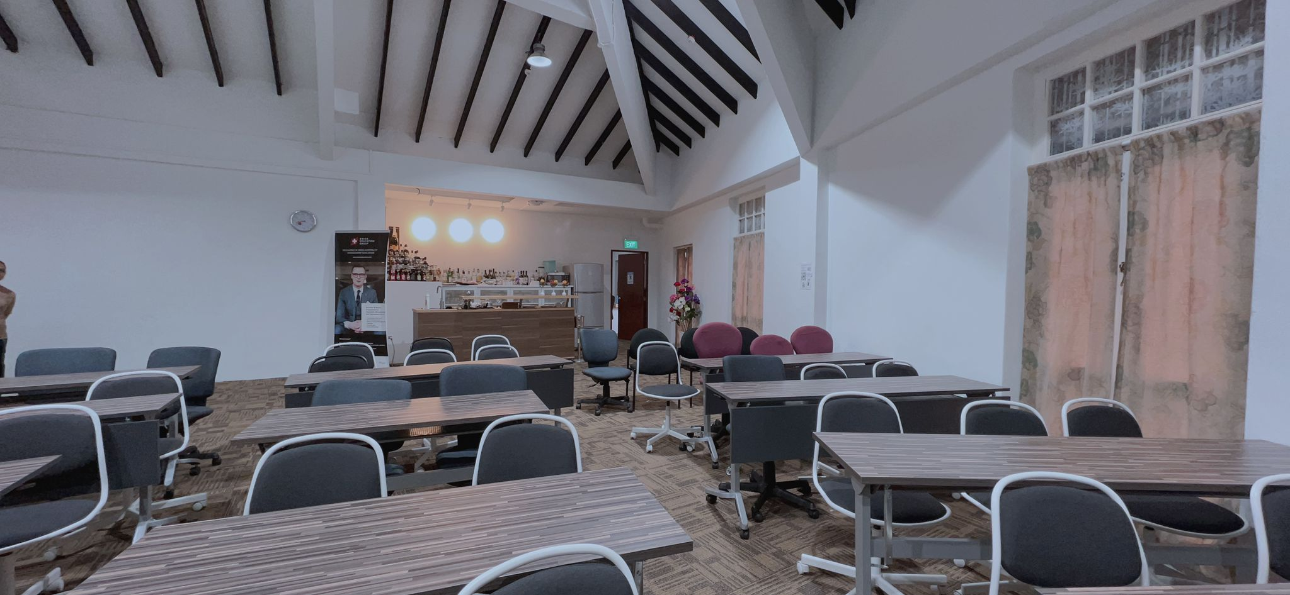
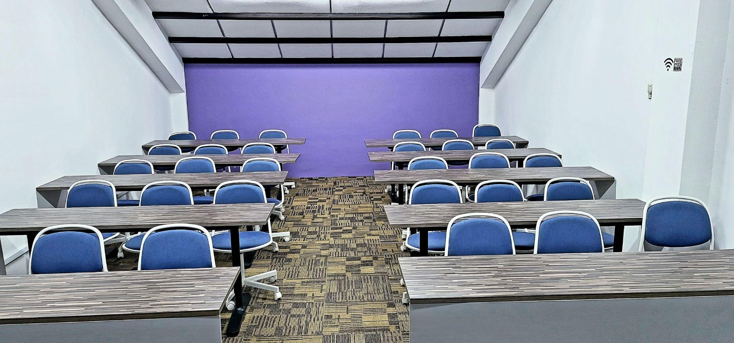
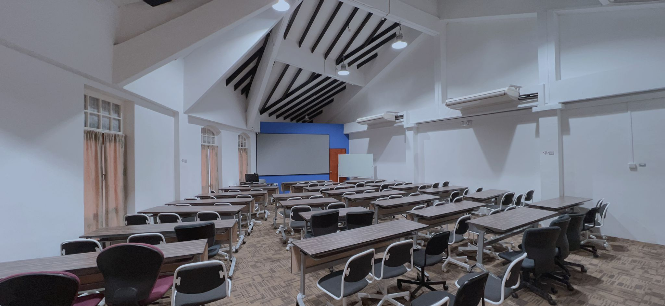
Facilities - TMC Academy
Classrooms

Slide 14

Student Services and Support ( Student Portal)
User ID: student ID (TMxx-xxxxx)
password: DOB (ddmmyyyy)
Access to:
Student Time Table
Teaching and assignment materials
Student Handbook (printed copy of student handbook is available in library for reference only)
Student Announcements
Attendance record
Result record

Slide 15
TMC Academy Pathway
UK Master's Degree / Postgraduate Diploma
12 to 14 months
UK Bachelor’s Degree
9 to 12 months
Higher Diploma(12 Months)+ *6 months IA
Business
Hospitality
Infocomm Technology
Psychology with Counselling
Mass Communication
Engineering
A LEVEL
Diploma (6 months) + *6 months IA
Foundation Diploma for Tertiary Studies
Diploma in Business
Diploma in Hospitality and Tourism Management*
Diploma in Information Technology
Grade 12
GCE O-Level / Secondary 4
12 to 14 months
Grade 9

Slide 16
UK Pathway vs TMC Academy
UK Bachelor’s Degree
= 360 Credit Points
Year 1
12 months in UK
= 120 credit points
TMC Higher Diploma
= YEAR 1 + YEAR 2
12 modules = 240 credit points
12 months no IA
18 months with IA
(12 to 18 months)
Year 2
12 months in UK
= 120 credit points
Year 3
12 months in UK
= 120 credit points
Bachelor’s Degree (top-up) -Year 3,
9-12 months
6 modules = 120 credit points

Slide 17
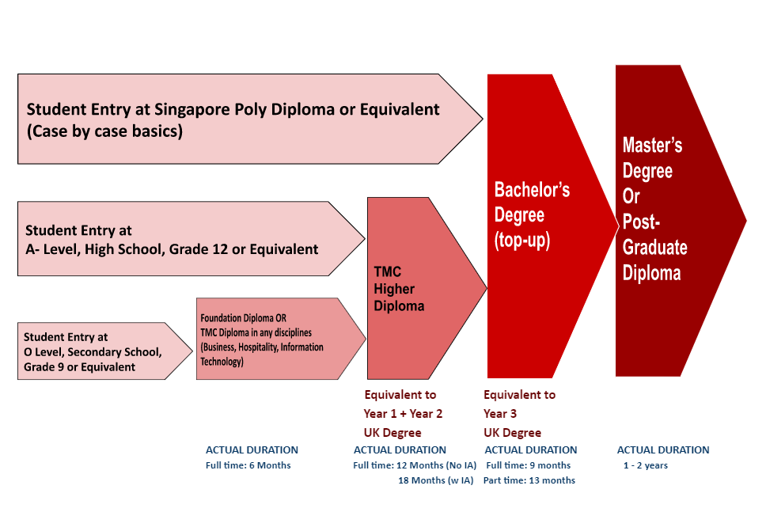
Pathway

Slide 18


Academic Partners
Course delivered in Singapore

Slide 19






Academic Partners
Course delivered in overseas
(UK, USA,Switzerland, Australia, etc)

Slide 20
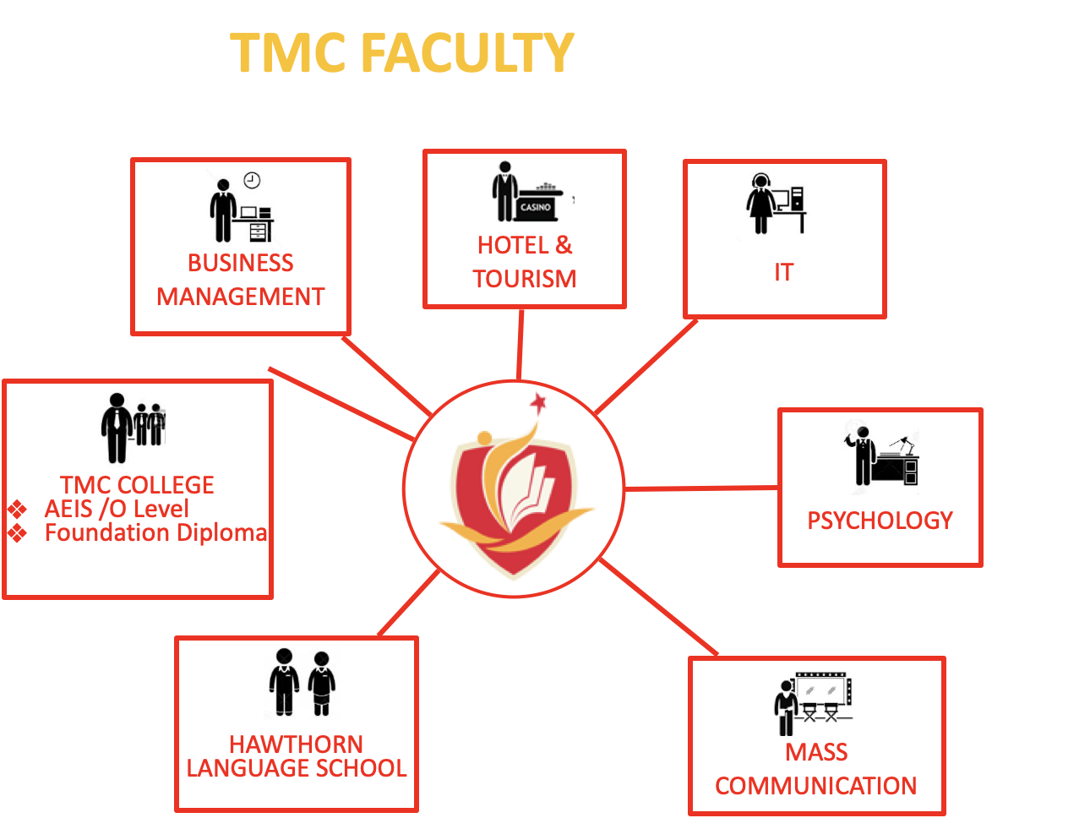

TMC ACADEMY - FACULTY
New Faculty: Engineering

Slide 21
Intake and Entry Requirement
⇒ Diploma / Foundation Diploma
Completed Secondary Education or Year 9
IELTS 5.5 or pass TMC Placement Test
Completed TMC Upper Intermediate A Level
⇒ Higher Diploma
Completed High School or Year 12
IELTS 6.00 pass TMC Placement Test
Completed TMC Upper Intermediate B Level
Intake Monthly (except Psychology)
January
February
March
April
May
July
August
September
October
November
December

Slide 22













Hawthorn Certificate in English
Hawthorn Singapore started as a franchisee of Melbourne University (Australia) which was established by the University of Melbourne in 2003. It was part of the worldwide network of Hawthorn English Language Centres.

Slide 23
Industrial Attachment
TMC Academy is one of the well-known private institutions in Singapore, has been established since 1981, TMC Academy has 41 years of experience in education with different stages from AEIS primary 2 school until Master’s Degree.
TMC Academy is the only institution that offers paid 6 months internship in Singapore for Business, Infocomm Technology and Hospitality.
👉List of Programmes with 6-months Industrial Attachment.
Duration: 12 months study + 6 months paid internship (For ‘A’ Level holders, Grade 12 or equivalent.)
Higher Diploma in Business Studies
Higher Diploma in Business Studies with Accounting
Higher Diploma in Business Studies with Human Resource Management
Higher Diploma in Business Studies with International Business
Higher Diploma in Business Studies with Logistics
Higher Diploma in Business Studies with Marketing
Higher Diploma in Hospitality and Tourism Management
Higher Diploma in Business Infocomm Technology

Slide 24
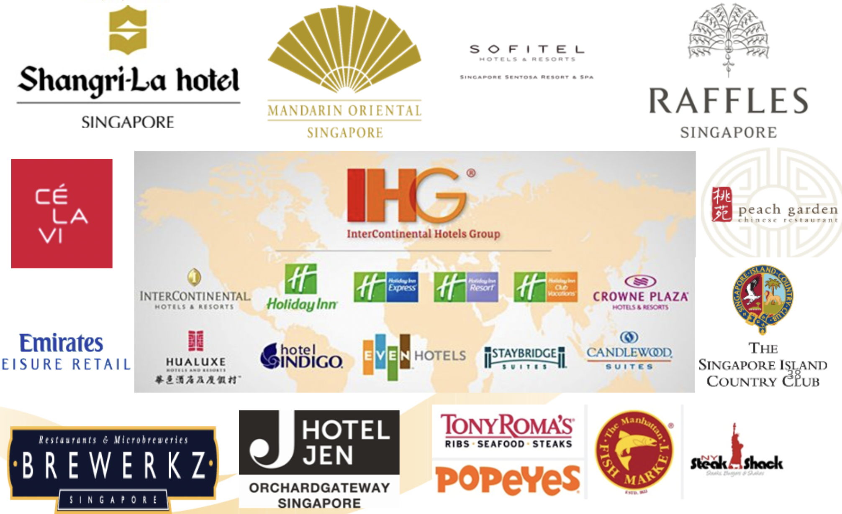
Industrial Attachment Partners

Slide 25
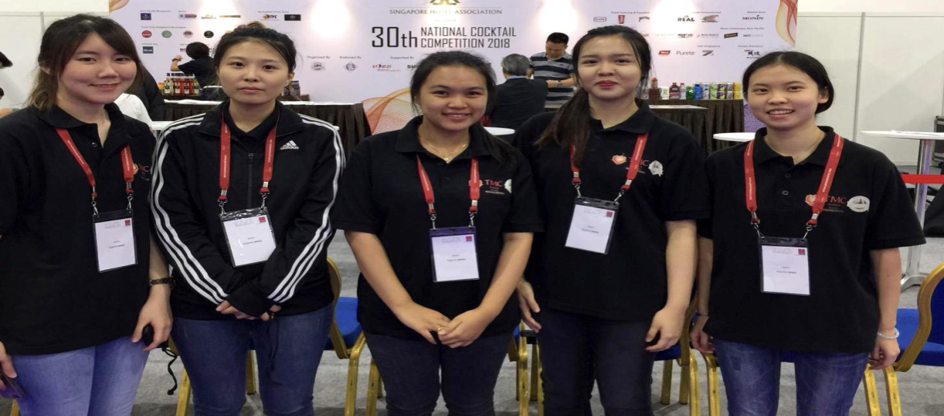
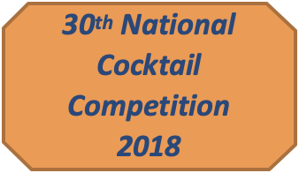



A Multitude of Learning & Networking Opportunities
Our strong link to industry associations & companies give you access to external industry events, seminars, competitions, workshops and job placement opportunities !!

Slide 26
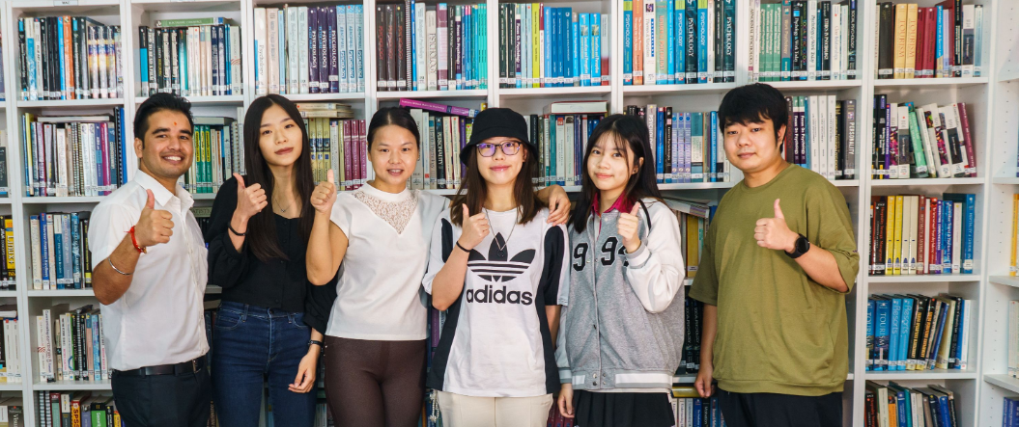

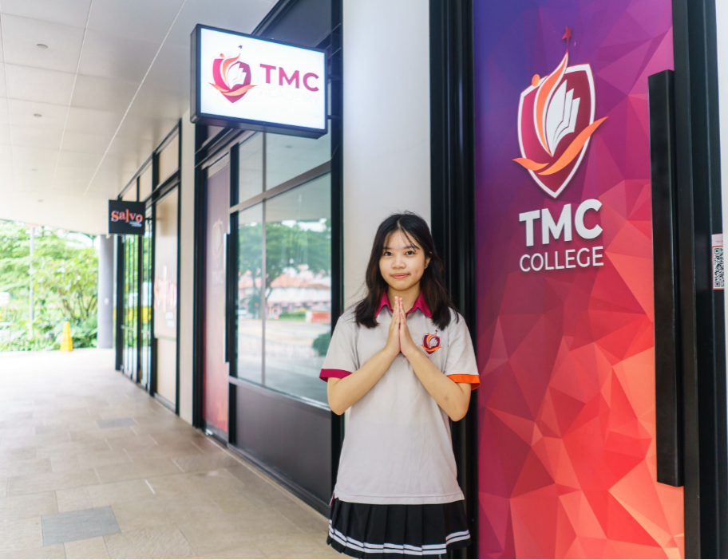
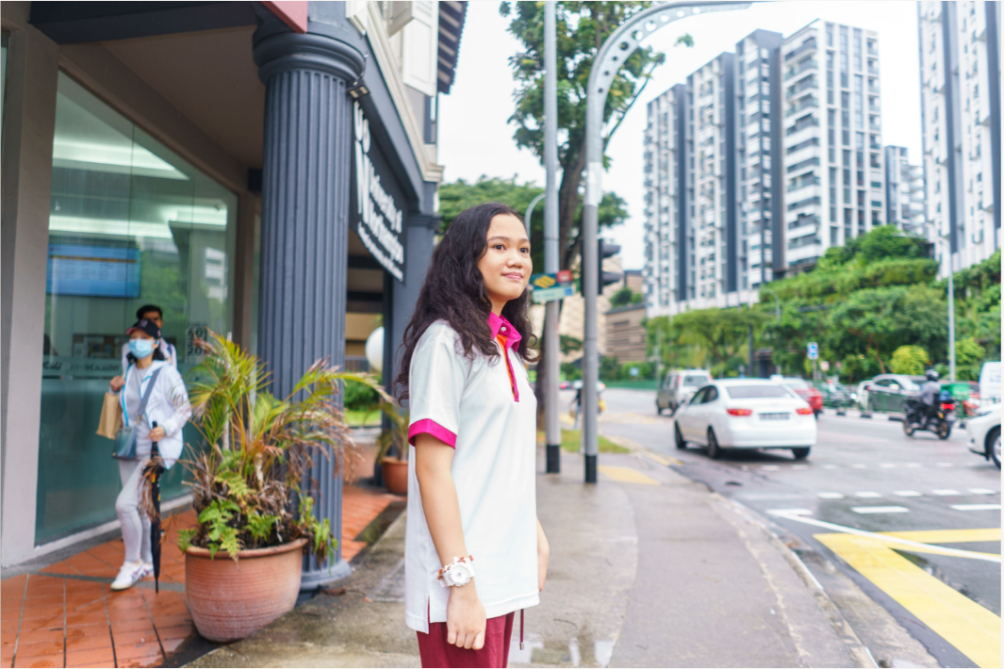
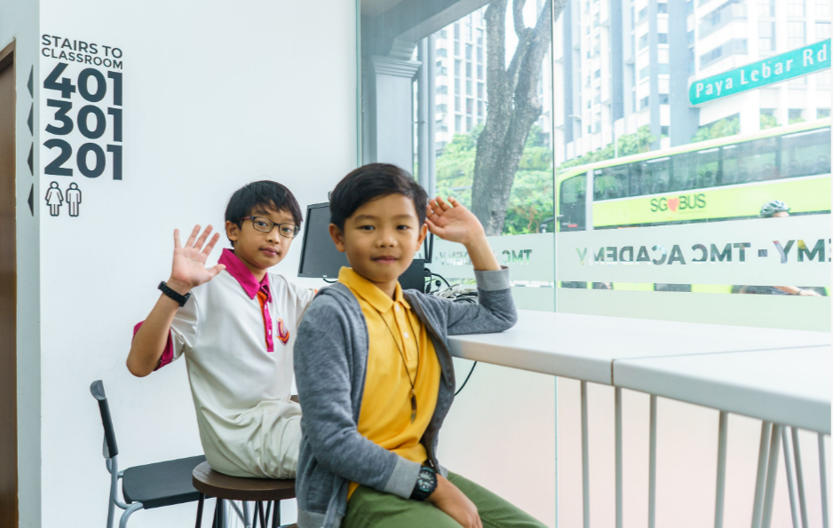
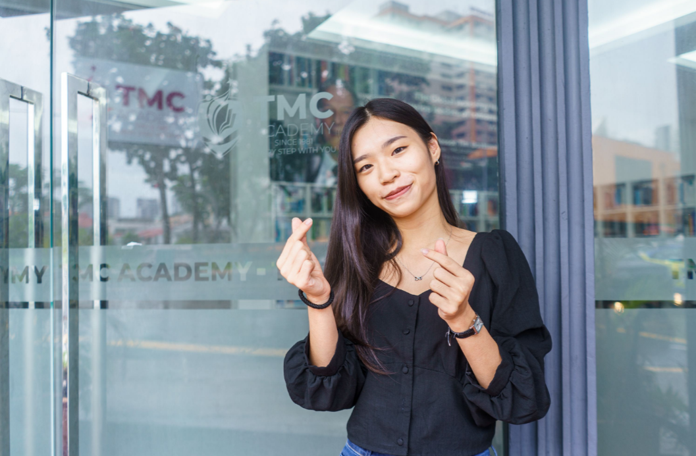
STUDENT PHOTOS

Slide 27
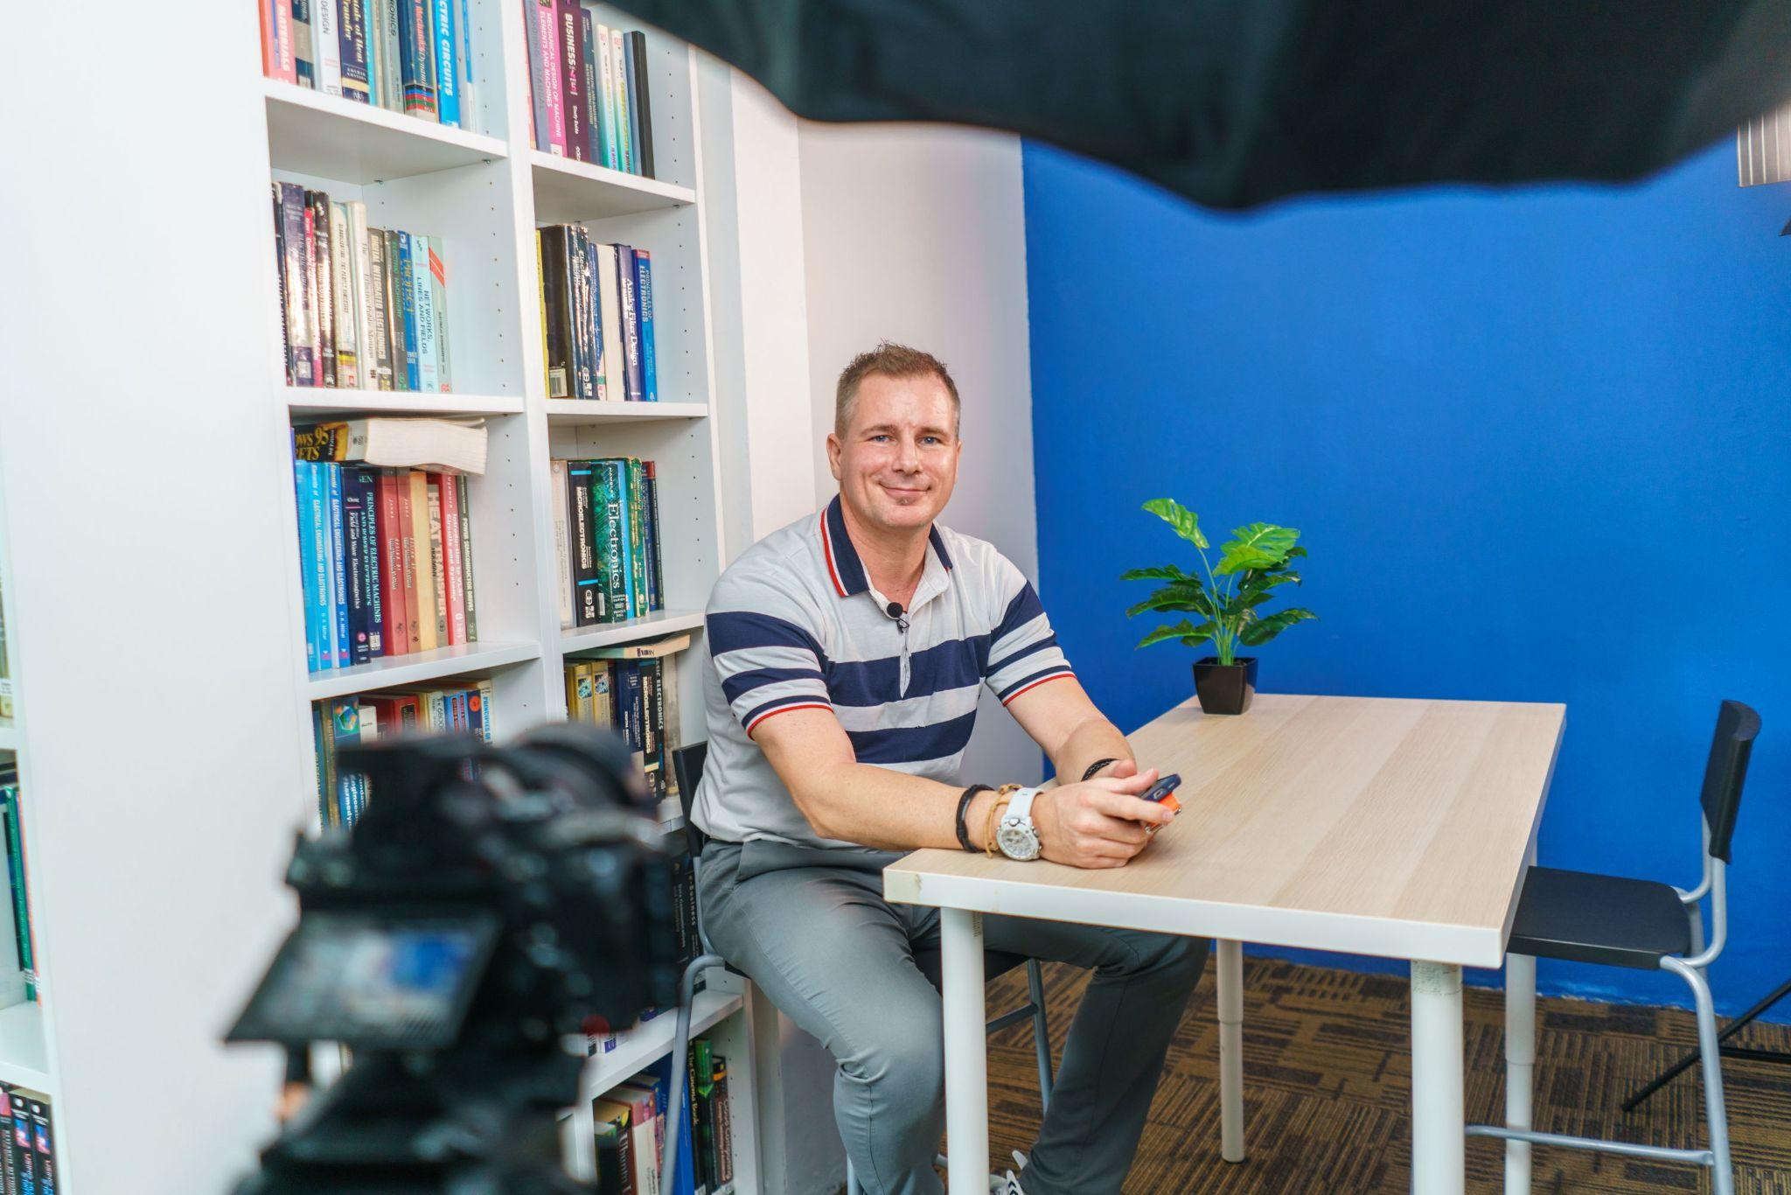
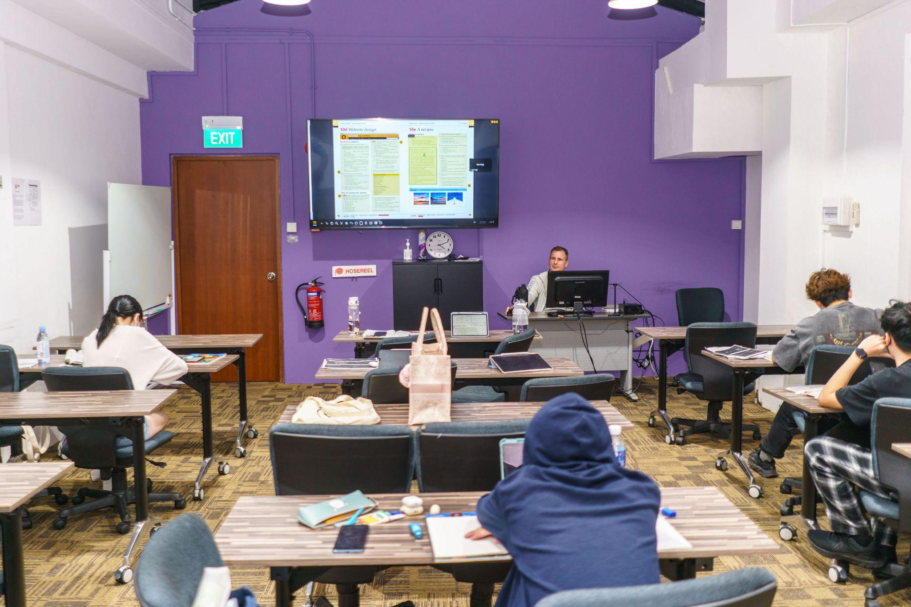
HAWTHORN TEACHER PHOTOS
Mr. Andrew Zajicek is a senior lecturer and at the moment he teaches Hawthorn English courses. He graduated with a bachelor's degree in Sports Management and worked and taught in sports camps in the US. He has taught English and Math at schools in Singapore and his native Czech republic. He is ESL certified in general and business English. Among his experience is also teaching IELTS, GMAT, SAT and GRE courses. Andrew started working for TMC in 2012. He believes that the more languages you know, the more opportunities to find what you’re looking for in life you get.

Slide 28
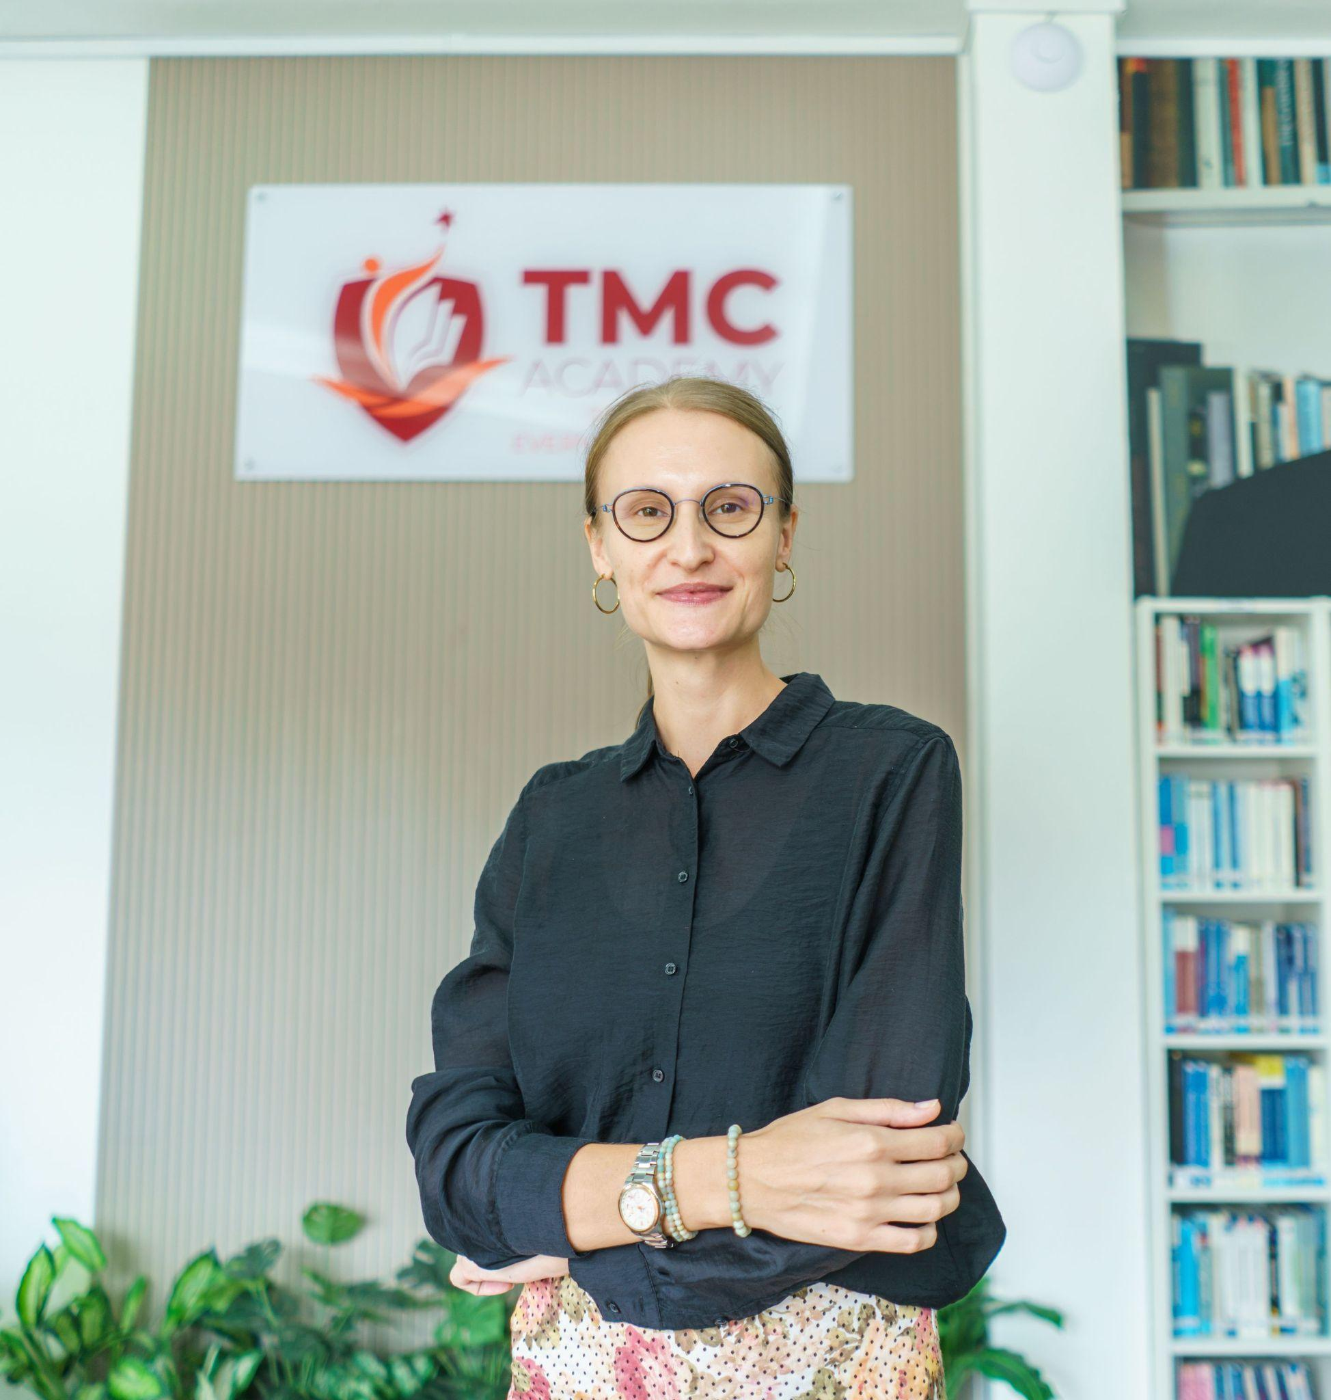
HOSPITALITY TEACHER PHOTOS
Be Inspired Today! Exploring TMC's Hospitality & Tourism programme with Ms Malgorzata Maria Kucmierczyk (Gosia), Malgorzata was born in Poland and received her Master’s in Tourism and Leisure from the University of Physical Education in Cracow.
She joined TMC in 2015 as a lecturer in the School of Hospitality and Tourism. Currently, Malgorzata is a senior lecturer and she teaches various modules for diploma, higher diploma and degree courses.

Slide 29
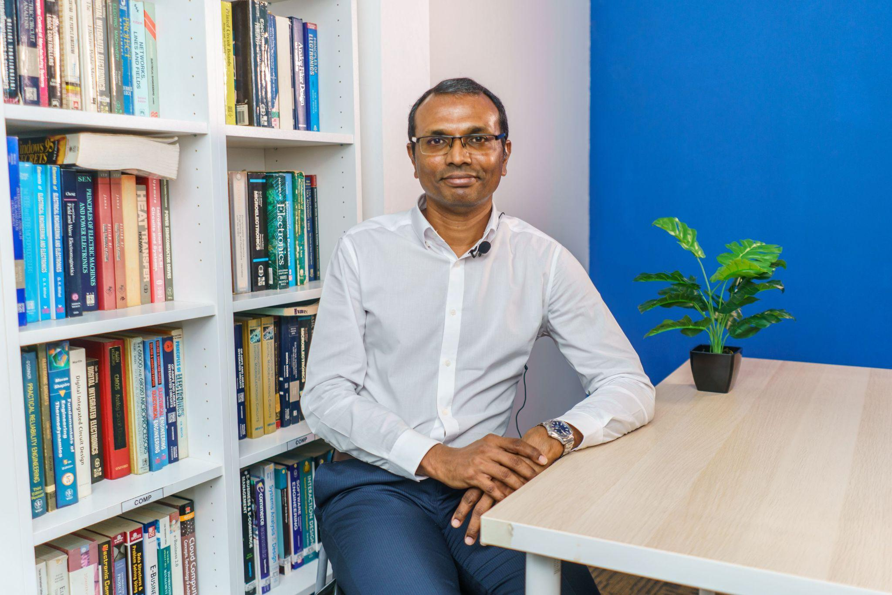
BUSINESS TEACHER PHOTOS
Mr K. Ashok Kumar is a Senior Lecturer with the School of Business and Law at TMC Academy, Singapore. He graduated with a Bachelor in Business Administration degree from the National University of Singapore in 1997, specialising in Finance.
He went on to obtain his ACCA qualifications in 2006 and also holds a Chartered Accountant (Singapore) qualification. In 2014 he completed a Specialist Diploma in Applied Learning and Teaching course at Singapore’s Republic Polytechnic as part of his continuing professional development.

Slide 30
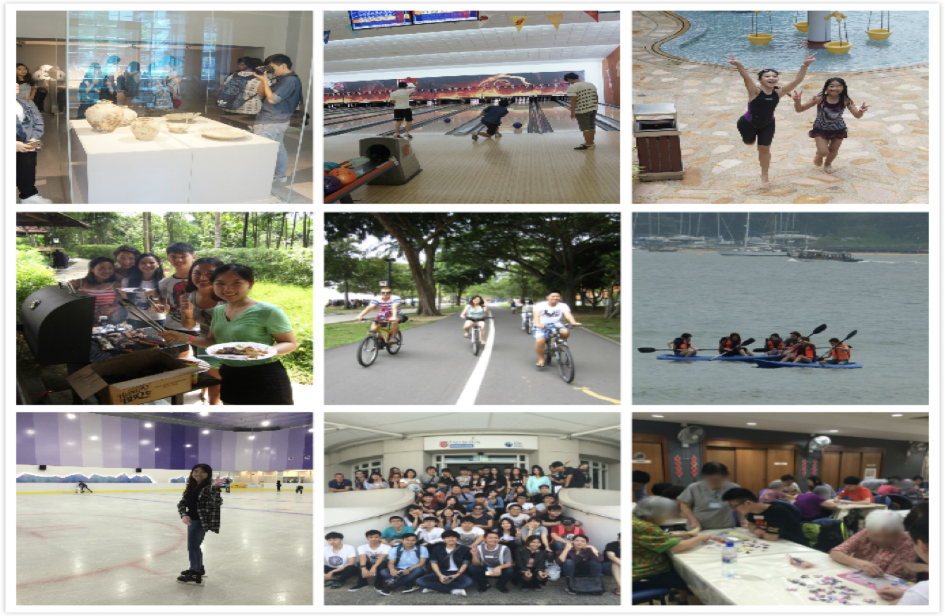
EXTRA-CURRICULAR ACTIVITIES

Slide 31
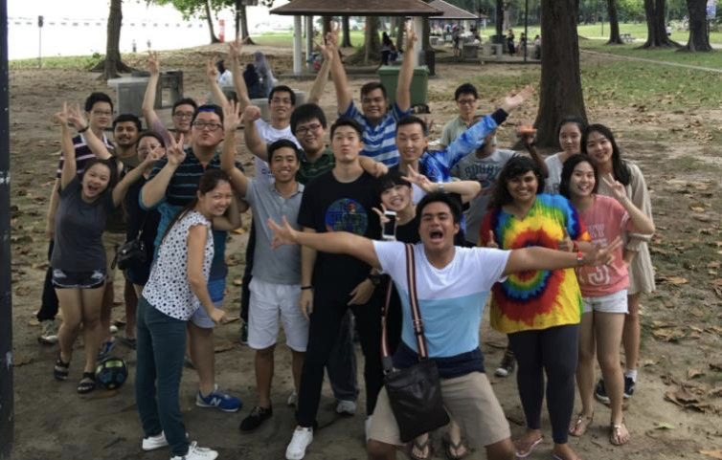
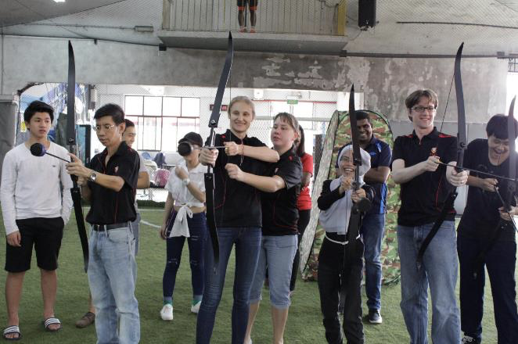
EXTRA-CURRICULAR ACTIVITIES

Slide 32
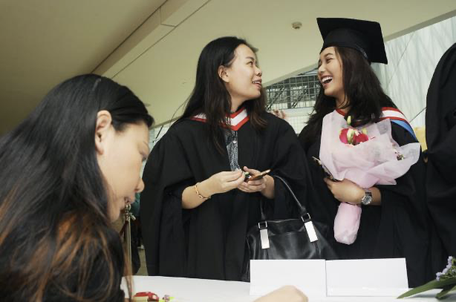
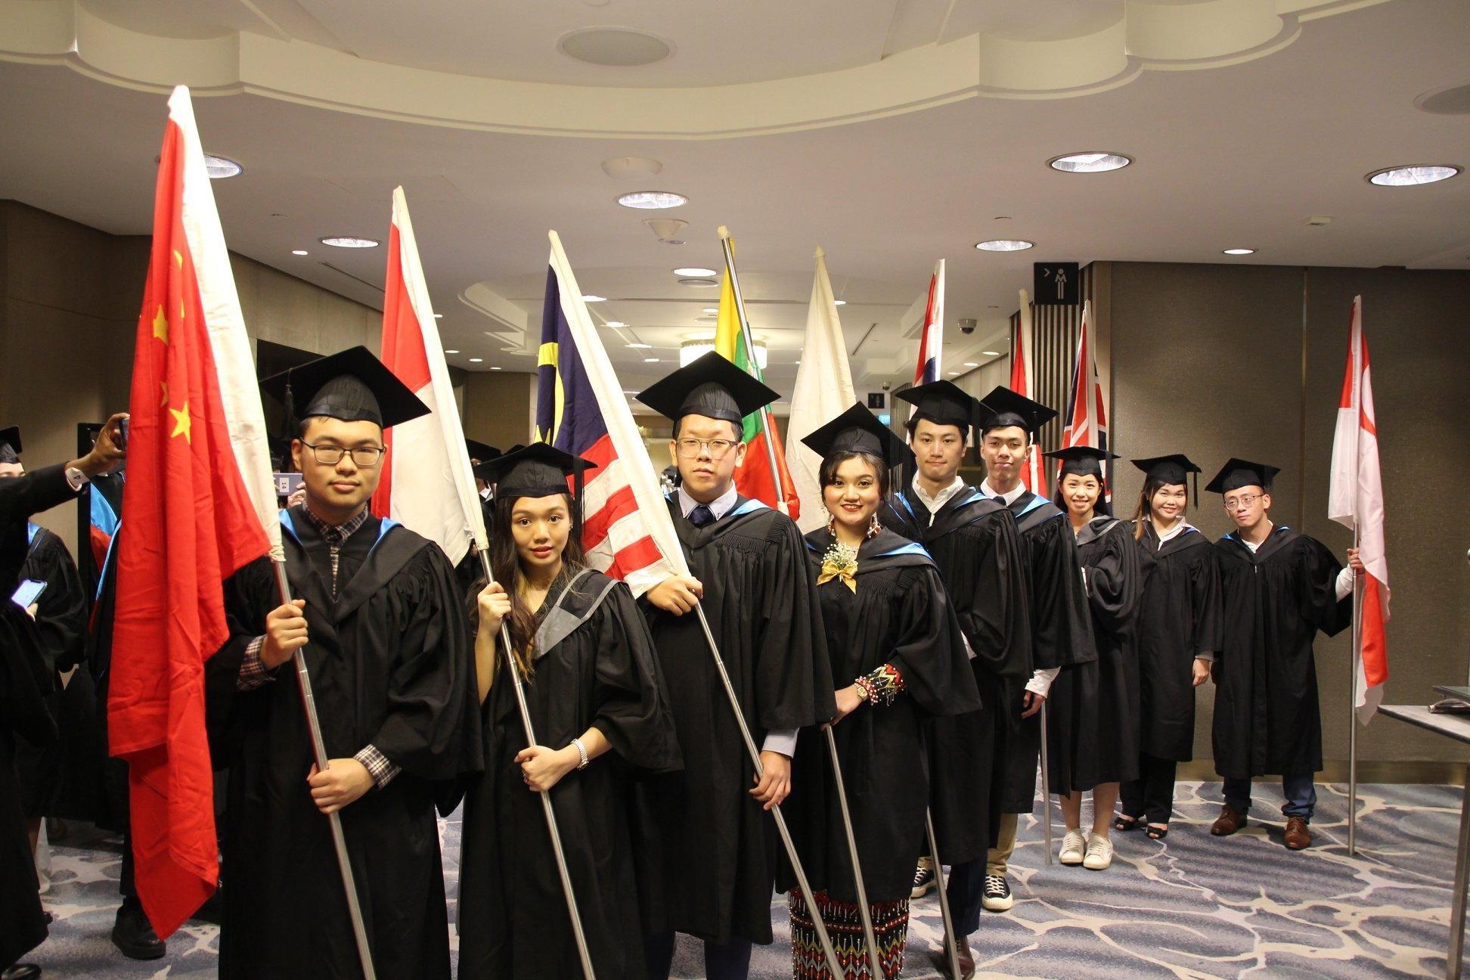





TMC GRADUATION

Slide 33
THANK YOU

